Slide 1
CIVIL HANDBOOK:
Participation, inclusion, engagement Third module: Trends, theories and analytical frameworks
László Kákai, PhD – Viktor Glied, PhD Department of Political Science and International Studies University of Pécs, Hungary

Slide 2
The following disclaimer shall be added to the inner pages of the publications and studies written by external independent bodies with support from the European Commission:
BG | Подкрепата на Европейската комисия за изготвянето на настоящата публикация не представлява одобрение на съдържанието, което отразява гледните точки само на авторите и не може да се търси отговорност от Комисията за всяка употреба, която може да бъде използвана за информацията, съдържаща се в нея.
CS | Podpora Evropské komise při tvorbě této publikace nepředstavuje souhlas s obsahem, který odráží pouze názory autorů, a Komise nemůže být zodpovědná za jakékoliv využití informací obsažených v této publikaci.
DA | Europa-Kommissionens støtte til produktionen af denne publikation udgør ikke en godkendelse af indholdet, som kun afspejler forfatternes egne synspunkter, og Kommissionen kan ikke holdes ansvarlig for den brug, der måtte blive gjort af de deri indeholdte oplysninger.
DE | Die Unterstützung der Europäischen Kommission für die Erstellung dieser Veröffentlichung stellt keine Billigung des Inhalts dar, welcher nur die Ansichten der Verfasser wiedergibt, und die Kommission kann nicht für eine etwaige Verwendung der darin enthaltenen Informationen haftbar gemacht werden.
EL | Η υποστήριξη της Ευρωπαϊκής Επιτροπής στην παραγωγή της παρούσας έκδοσης δεν συνιστά αποδοχή του περιεχομένου, το οποίο αντικατοπτρίζει αποκλειστικά τις απόψεις των συντακτών, και η Επιτροπή δεν μπορεί να αναλάβει την ευθύνη για οποιαδήποτε χρήση των πληροφοριών που περιέχονται σε αυτήν.
EN | The European Commission's support for the production of this publication does not constitute an endorsement of the contents, which reflect the views only of the authors, and the Commission cannot be held responsible for any use which may be made of the information contained therein.
ES | El apoyo de la Comisión Europea para la producción de esta publicación no constituye una aprobación del contenido, el cual refleja únicamente las opiniones de los autores, y la Comisión no se hace responsable del uso que pueda hacerse de la información contenida en la misma.
ET | Euroopa Komisjoni toetus käesoleva väljaande koostamisele ei tähenda väljaandes esitatud sisu kinnitamist. Väljaandes esitatud sisu peegeldab vaid autorite seisukohti. Euroopa Komisjon ei vastuta selles sisalduva teabe kasutamise eest.
FI | Euroopan komission tuki tämän julkaisun tuottamiseen ei tarkoita sitä, että sisältö, joka kuvastaa pelkästään tekijöiden näkemyksiä, saa kannatusta, eikä komissiota voida saattaa vastuuseen niiden sisältämien tietojen mahdollisesta käytöstä.
FR | Le soutien de la Commission européenne à la production de cette publication ne constitue pas une approbation du contenu, qui reflète uniquement le point de vue des auteurs, et la Commission ne peut pas être tenue responsable de toute utilisation qui pourrait être faite des informations qu’elle contient.
GA | Ní hionann tacaíocht an Choimisiúin Eorpaigh do tháirgeadh an fhoilseacháin seo agus formhuiniú ar ábhair an fhoilseacháin, lena léirítear tuairimí na n-údar amháin, agus ní féidir freagracht a chur ar an gCoimisiún as aon úsáid a d’fhéadfaí a bhaint as an bhfaisnéis atá ann.
HR | Potpora Europske komisije proizvodnji ove publikacije ne predstavlja potporu sadržaju koji odražava samo stavove autora i Komisija ne može biti odgovorna za uporabu sadržanih informacija.

Slide 3
HU | Az Európai Bizottság támogatása ezen kiadvány elkészítéséhez nem jelenti a tartalom jóváhagyását, amely kizárólag a szerzők álláspontját tükrözi, valamint a Bizottság nem tehető felelőssé ezen információk bárminemű felhasználásáért.
IT | Il sostegno della Commissione europea alla produzione di questa pubblicazione non costituisce un'approvazione del contenuto, che riflette esclusivamente il punto di vista degli autori, e la Commissione non può essere ritenuta responsabile per l'uso che può essere fatto delle informazioni ivi contenute.
LT | Europos Komisijos parama šio leidinio rengimui nereiškia pritarimo jo turiniui, kuriame pateikiama autorių nuomonė, todėl Europos Komisija negali būti laikoma atsakinga už informaciją panaudotą šiame leidinyje.
LV | Eiropas Komisijas atbalsts šīs publikācijas sagatavošanai nav uzskatāms par satura apstiprinājumu, kas atspoguļo tikai autoru viedokļus, un Komisija nevar būt atbildīga par tajā ietvertās informācijas jebkādu izmantošanu.
MT | L-appoġġ tal-Kummissjoni Ewropea għall-produzzjoni ta’ din il-pubblikazzjoni ma jikkostitwixxix approvazzjoni tal-kontenut, li jirrifletti biss il-fehmiet tal-awturi, u l-Kummissjoni ma tistax tinżamm responsabbli għal kwalunkwe użu li jista’ jsir mill-informazzjoni li tinsab fiha.
NL | De steun van de Europese Commissie voor de productie van deze publicatie houdt geen goedkeuring van de inhoud in. De inhoud geeft de standpunten van de auteurs weer en de Commissie kan niet aansprakelijk worden gesteld voor het gebruik dat eventueel wordt gemaakt van de daarin opgenomen informatie.
PL | Wsparcie Komisji Europejskiej dla produkcji tej publikacji nie stanowi poparcia dla treści, które odzwierciedlają jedynie poglądy autorów, a Komisja nie może zostać pociagnięta do odpowiedzialności za jakiekolwiek wykorzystanie informacji w niej zawartych.
PT | O apoio da Comissão Europeia à produção desta publicação não constitui um aval do seu conteúdo, que reflete unicamente o ponto de vista dos autores, e a Comissão não pode ser considerada responsável por eventuais utilizações que possam ser feitas com as informações nela contidas.
RO | Sprijinul acordat de Comisia Europeană pentru elaborarea acestei publicații nu constituie o aprobare a conținutului, care reflectă doar opiniile autorilor, iar Comisia nu poate fi trasă la răspundere pentru orice utilizare a informațiilor conținute în aceasta.
SK | Podpora Európskej komisie na výrobu tejto publikácie nepredstavuje súhlas s obsahom, ktorý odráža len názory autorov, a Komisia nemôže byť zodpovedná za prípadné použitie informácií, ktoré sú v nej obsiahnuté.
SL | Podpora Evropske komisije za pripravo te publikacije ne pomeni potrditve vsebine, ki izraža le mnenja avtorjev, in Komisija ne more biti odgovorna za kakršno koli uporabo informacij, ki jih vsebuje.
SV | Europeiska Kommissionens stöd åt framställningen av detta dokument utgör inte ett godkännande av dess innehåll, vilket endast återspeglar upphovsmännens åsikter, och Kommissionen kan inte hållas ansvarigt för någon användning av informationen i det.

Slide 4
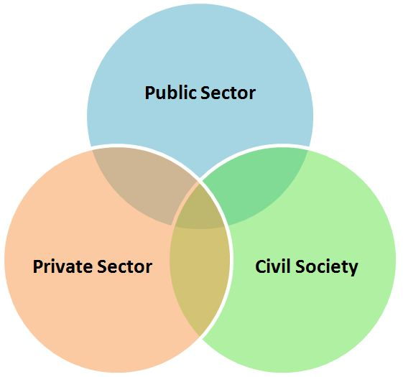
Introduction 1
Civil sector definition
A sphere that consists of non-governmental and not-for-profit organizations, which have a presence in public life, demonstrating the interests and values of their members or others, based on ethical, cultural, political, scientific, religious or humanitarian considerations.
Civil society organizations (CSOs) play an essential role in contexts of state service reduction or lack of services, particularly in countries of protracted crisis.

Slide 5
Introduction 2
Civil Society is derived from the Latin term societas civilis.
The term ‘’Civil Society” has different meanings.
From civitas sive societas civilis sive res publica (city-state or civil society or commonwealth) to a fashionable “catch-phrase”.

Slide 6
Introduction 3
Civil sector’s tasks
In the 21st century, civil society
can still be considered:
the immune system of society,
the moral compass of the state, and
the defender of the democratic system.
Civil society organizations play multiple roles. They
are important source of information for both citizens and government,
monitor government policies and actions, moreover keep the government accountable (watchdog function),
engage in advocacy and offer alternative policies for government, the private sector, and other institutions.

Slide 7
Introduction 4
Civil society’s roles include:
service provider (e.g. running primary schools and providing basic community health care services)
advocate/campaigner (e.g. lobbying governments or business on issues including indigenous rights or the environment)
watchdog (e.g. monitoring government compliance with human rights treaties)
building active citizenship (e.g. motivating civic engagement at the local level and engagement with local, regional and national governance)
participating in global regimes

Slide 8
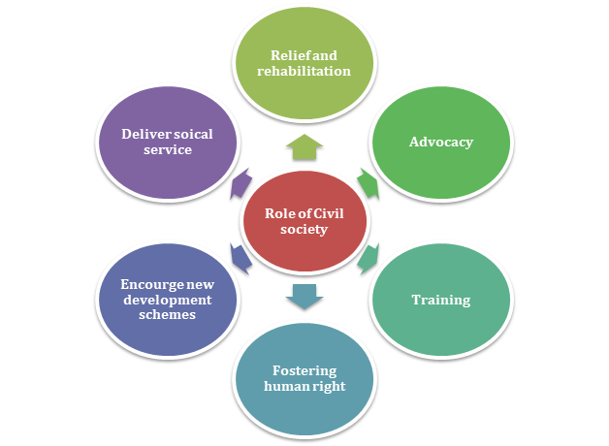
Introduction 5
Civil societies’ categories
Lobby groups
political interest groups
special interest groups
voluntary associations
pressure groups
organised interest groups
non-governmental organizations
non-profit organizations
policy networks
Source: https://corpbiz.io/learning/civil-society-and-ngos/

Slide 9
Inclusion 1
The act of including someone or something as part of a group, list, or a person or thing that is included.
Source: https://www.channelfutures.com/diversity-inclusion/stop-paying-lip-service-exertis-reveals-plan-for-greater-diversity-and-inclusion

Slide 10
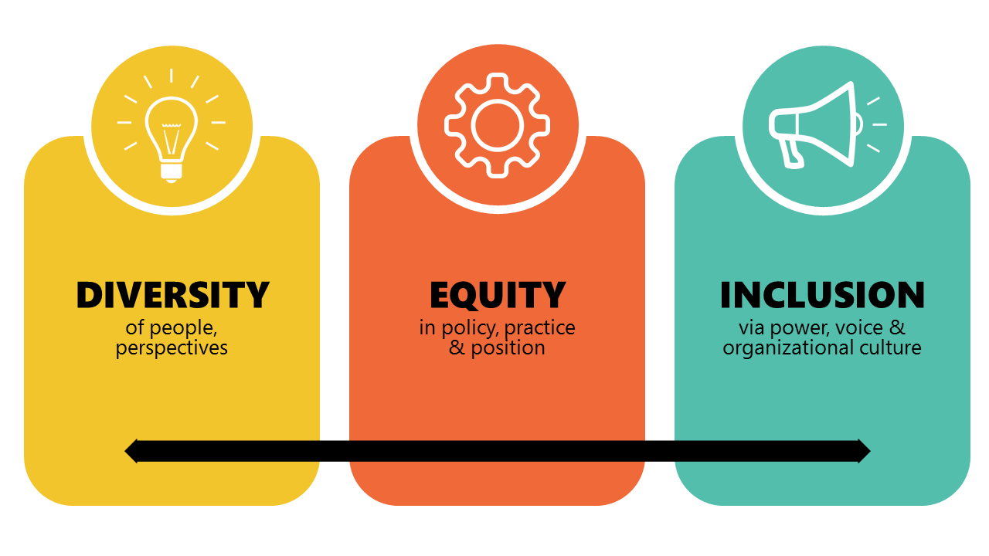
Inclusion 2
By the rise of the Internet and digitization, civic engagement strategies are also changing:
instead of unilateral information transfer, cooperative community experiences based on discourse and information exchange represent the future
the success of an initiative/project or organization is increasingly determined by a strong online presence.
The appearance of various social media platforms has created virtual spaces that provide the opportunity to get involved in a form that takes place in a parallel but connected reality.
Source: https://www.linkedin.com/pulse/please-remove-diversity-equity-inclusion-dei-from-your-holland

Slide 11
Civil Society
Narrow sense: all kinds of non-political associations, NGO’s, citizens’ initiatives etc.
Descriptive
Broader sense: not only associations, but also particular values (e.g., tolerance, solidarity, respect and trust in democratic institutions etc.)
Descriptive + normative

Slide 12
Global Civil Society 1
Like the term ’globalization’, the definition of ‘global civil society’ is debated and contested, and is one of the reason it is attractive to stakeholders from differing fields of interest and activity.
Sometimes it is described and explained in terms of new social movements that show up globally;
In international relations it is called ‘transnational civil society;
In sociology it is identified with the emergence of a ‘world society’;
In economics it is related to the intenational labor movement and the public reaction to globalized markets and neoliberalism;
In political science the focus is on the characteristics of spreading democracy around the world.
Normatively, global civil society is associated with initiatives that embody certain values and ethical principles.
Examples: Médécins sans Frontiers, Save the Children, Oxfam, Amnesty International, WWF, Red Cross, Greenpeace, FoE, Human Rights Watch
Source: https://www.amazon.com/Global-Society-Contemporary-Political-Theory/dp/052189462X

Slide 13
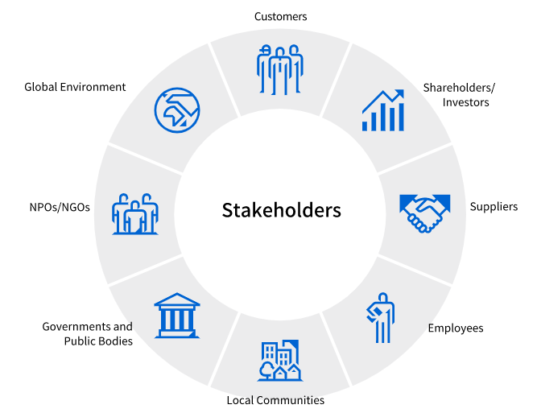
Global Civil Society 2
Recently have seen the remarkable rise of civil society and citizen action as a global phenomenon. This transnational activity has been facilitated by:
The wider process of globalization.
The ICT revolution, which has provided unprecedented levels of access to information.
The emergence of ‘global issues’ and global threats like climate change or pandemics.
Global civil society contributed to:
Opening up a global public space for debate and actions.
Shaping the political agenda and generating a cosmopolitan set of norms and citizen demands that transcend national boundaries.
Reshaping multilateralism.
Source: https://www.global.toshiba/ww/sustainability/corporate/stakeholders.html

Slide 14
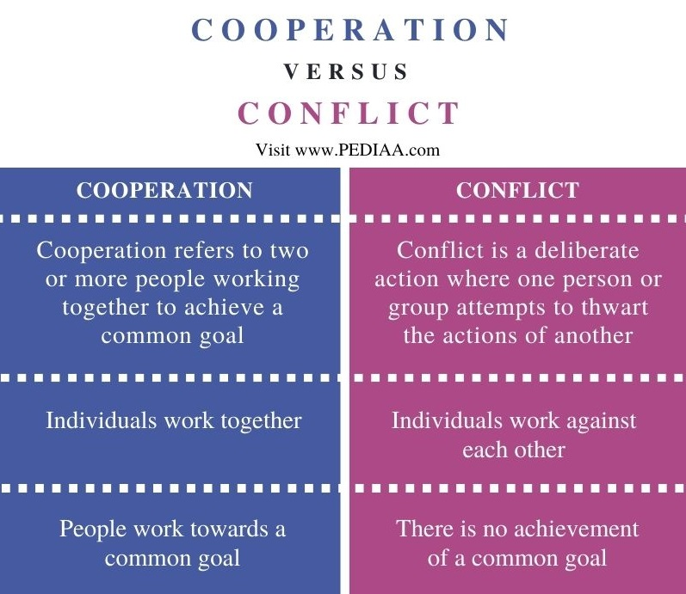
Global Civil Society 3
Conflict is the opposite of cooperation. Conflict is a deliberate action where one person attempts to thwart the actions of another. This can also involve one group of people attempting to block the actions of another group.
„A social relationship will be referred to as conflict in so far as an action within it is oriented intentional to carrying out the actor’s own will against the resistance of the other party or parties.” (Max Weber)
Source:
https://pediaa.com/what-is-the-difference-between-cooperation-and-conflict-in-sociology/

Slide 15
Global Civil Society 4
Souce: https://sdgs.un.org/goals

Slide 16
Global Civil Society 5 – The 2030 AGENDA / SDGs
1. End poverty in all forms everywhere
2. End hunger achieve food security and improved nutrition and promote sustainable agriculture
3. Ensure healthy lives and promote well-being for all at all ages
4. Ensure inclusive and equitable quality education and promote lifelong learning opportunities for all
5. Achieve gender equality and empower all women and girls
6. Ensure availability and sustainable management of water and sanitation for all
7. Ensure access to affordable, reliable, sustainable and modern energy for all
8. Promote sustained, inclusive and sustainable economic growth, full and productive employment and decent work for all
9. Build resilient infrastructure, promote inclusive and sustainable industrialization and foster innovation
10. Reduce inequality within and among countries
11. Make cities and human settlements inclusive, safe, resilient and sustainable
12. Ensure sustainable consumption and production patterns
13. Take urgent action to combat climate change and its impacts acknowledging that the United Nations Framework Convention on Climate Change is the primary international, intergovernmental forum for negotiating the global response to climate change
14. Conserve and sustainably use the oceans, seas and marine resources for sustainable development
15. Protect, restore and promote sustainable use of terrestrial ecosystems, sustainably manage forests, combat desertification, and halt and reverse land degradation and halt biodiversity loss
16. Promote peaceful and inclusive societies for sustainable development, provide access to justice for all and build effective, accountable and inclusive institutions at all levels
17. Strengthen the means of implementation and revitalize the global partnership for sustainable development
https://sdgs.un.org/goals

Slide 17
Bibliography
Books
Cohen, Jean L. – Arato, Andrew (1994): Civil Society and Political Theory. The MIT Press.
Edwards, Michael (2013): Oxford Handbook of Civil Society. Oxford University Press Inc.
Global Civil Society (2004): (Global Civil Society – Year Books) Eds. Helmut K Anheier, Mary Kaldor, Marlies Glasius. SAGE Publications Ltd.
Hall, John A. (1995): Civil Society – Theory History Comparison. Polity Press.
Kákai, László (2020): Development or reflections of the nonprofit sector in Central and Eastern Europe and Hungary. Politics in Central Europe 16:S1 pp. 135-158.
Kákai, László – Glied, Viktor (2017): Sketch of the Hungarian non-profit sector after the regime change
Civil Studies 14:3 pp. 13-34.
Keane, John (2003): Global Civil Society. Cambridge University Press.
Lang, Sabine (2014): NGOs, Civil Society, and the Public Sphere. Cambridge University Press.
United Nations. https://sdgs.un.org/goals

Slide 18
Thank you for your
attention!

