Slide 1
SECURITY AND PEACE IN AN UNCERTAIN WORLD First module: Trends, theories and analytical frameworks
1. Introduction: Contemporary Conflict Trends and Security Challenges Péter Kacziba, PhD Department of Political Science and International Studies University of Pécs

Slide 2
The following disclaimer shall be added to the inner pages of the publications and studies written by external independent bodies with support from the European Commission:
BG | Подкрепата на Европейската комисия за изготвянето на настоящата публикация не представлява одобрение на съдържанието, което отразява гледните точки само на авторите и не може да се търси отговорност от Комисията за всяка употреба, която може да бъде използвана за информацията, съдържаща се в нея.
CS | Podpora Evropské komise při tvorbě této publikace nepředstavuje souhlas s obsahem, který odráží pouze názory autorů, a Komise nemůže být zodpovědná za jakékoliv využití informací obsažených v této publikaci.
DA | Europa-Kommissionens støtte til produktionen af denne publikation udgør ikke en godkendelse af indholdet, som kun afspejler forfatternes egne synspunkter, og Kommissionen kan ikke holdes ansvarlig for den brug, der måtte blive gjort af de deri indeholdte oplysninger.
DE | Die Unterstützung der Europäischen Kommission für die Erstellung dieser Veröffentlichung stellt keine Billigung des Inhalts dar, welcher nur die Ansichten der Verfasser wiedergibt, und die Kommission kann nicht für eine etwaige Verwendung der darin enthaltenen Informationen haftbar gemacht werden.
EL | Η υποστήριξη της Ευρωπαϊκής Επιτροπής στην παραγωγή της παρούσας έκδοσης δεν συνιστά αποδοχή του περιεχομένου, το οποίο αντικατοπτρίζει αποκλειστικά τις απόψεις των συντακτών, και η Επιτροπή δεν μπορεί να αναλάβει την ευθύνη για οποιαδήποτε χρήση των πληροφοριών που περιέχονται σε αυτήν.
EN | The European Commission's support for the production of this publication does not constitute an endorsement of the contents, which reflect the views only of the authors, and the Commission cannot be held responsible for any use which may be made of the information contained therein.
ES | El apoyo de la Comisión Europea para la producción de esta publicación no constituye una aprobación del contenido, el cual refleja únicamente las opiniones de los autores, y la Comisión no se hace responsable del uso que pueda hacerse de la información contenida en la misma.
ET | Euroopa Komisjoni toetus käesoleva väljaande koostamisele ei tähenda väljaandes esitatud sisu kinnitamist. Väljaandes esitatud sisu peegeldab vaid autorite seisukohti. Euroopa Komisjon ei vastuta selles sisalduva teabe kasutamise eest.
FI | Euroopan komission tuki tämän julkaisun tuottamiseen ei tarkoita sitä, että sisältö, joka kuvastaa pelkästään tekijöiden näkemyksiä, saa kannatusta, eikä komissiota voida saattaa vastuuseen niiden sisältämien tietojen mahdollisesta käytöstä.
FR | Le soutien de la Commission européenne à la production de cette publication ne constitue pas une approbation du contenu, qui reflète uniquement le point de vue des auteurs, et la Commission ne peut pas être tenue responsable de toute utilisation qui pourrait être faite des informations qu’elle contient.
GA | Ní hionann tacaíocht an Choimisiúin Eorpaigh do tháirgeadh an fhoilseacháin seo agus formhuiniú ar ábhair an fhoilseacháin, lena léirítear tuairimí na n-údar amháin, agus ní féidir freagracht a chur ar an gCoimisiún as aon úsáid a d’fhéadfaí a bhaint as an bhfaisnéis atá ann.
HR | Potpora Europske komisije proizvodnji ove publikacije ne predstavlja potporu sadržaju koji odražava samo stavove autora i Komisija ne može biti odgovorna za uporabu sadržanih informacija.

Slide 3
HU | Az Európai Bizottság támogatása ezen kiadvány elkészítéséhez nem jelenti a tartalom jóváhagyását, amely kizárólag a szerzők álláspontját tükrözi, valamint a Bizottság nem tehető felelőssé ezen információk bárminemű felhasználásáért.
IT | Il sostegno della Commissione europea alla produzione di questa pubblicazione non costituisce un'approvazione del contenuto, che riflette esclusivamente il punto di vista degli autori, e la Commissione non può essere ritenuta responsabile per l'uso che può essere fatto delle informazioni ivi contenute.
LT | Europos Komisijos parama šio leidinio rengimui nereiškia pritarimo jo turiniui, kuriame pateikiama autorių nuomonė, todėl Europos Komisija negali būti laikoma atsakinga už informaciją panaudotą šiame leidinyje.
LV | Eiropas Komisijas atbalsts šīs publikācijas sagatavošanai nav uzskatāms par satura apstiprinājumu, kas atspoguļo tikai autoru viedokļus, un Komisija nevar būt atbildīga par tajā ietvertās informācijas jebkādu izmantošanu.
MT | L-appoġġ tal-Kummissjoni Ewropea għall-produzzjoni ta’ din il-pubblikazzjoni ma jikkostitwixxix approvazzjoni tal-kontenut, li jirrifletti biss il-fehmiet tal-awturi, u l-Kummissjoni ma tistax tinżamm responsabbli għal kwalunkwe użu li jista’ jsir mill-informazzjoni li tinsab fiha.
NL | De steun van de Europese Commissie voor de productie van deze publicatie houdt geen goedkeuring van de inhoud in. De inhoud geeft de standpunten van de auteurs weer en de Commissie kan niet aansprakelijk worden gesteld voor het gebruik dat eventueel wordt gemaakt van de daarin opgenomen informatie.
PL | Wsparcie Komisji Europejskiej dla produkcji tej publikacji nie stanowi poparcia dla treści, które odzwierciedlają jedynie poglądy autorów, a Komisja nie może zostać pociagnięta do odpowiedzialności za jakiekolwiek wykorzystanie informacji w niej zawartych.
PT | O apoio da Comissão Europeia à produção desta publicação não constitui um aval do seu conteúdo, que reflete unicamente o ponto de vista dos autores, e a Comissão não pode ser considerada responsável por eventuais utilizações que possam ser feitas com as informações nela contidas.
RO | Sprijinul acordat de Comisia Europeană pentru elaborarea acestei publicații nu constituie o aprobare a conținutului, care reflectă doar opiniile autorilor, iar Comisia nu poate fi trasă la răspundere pentru orice utilizare a informațiilor conținute în aceasta.
SK | Podpora Európskej komisie na výrobu tejto publikácie nepredstavuje súhlas s obsahom, ktorý odráža len názory autorov, a Komisia nemôže byť zodpovedná za prípadné použitie informácií, ktoré sú v nej obsiahnuté.
SL | Podpora Evropske komisije za pripravo te publikacije ne pomeni potrditve vsebine, ki izraža le mnenja avtorjev, in Komisija ne more biti odgovorna za kakršno koli uporabo informacij, ki jih vsebuje.
SV | Europeiska Kommissionens stöd åt framställningen av detta dokument utgör inte ett godkännande av dess innehåll, vilket endast återspeglar upphovsmännens åsikter, och Kommissionen kan inte hållas ansvarigt för någon användning av informationen i det.

Slide 4
Introduction
Social science identify different types of “conflicts”: intrapersonal or interpersonal, intra-group or inter-group, latent or manifest, ad hoc and structural.
IR is mostly preoccupied with state-based armed conflicts.
According to archaeological evidence, the first primitive warfare took place around 14000 BC and from the Neolithic period onwards (Keeley, 1996).
Calculations estimates that between 3500 BC and the early 1980s approximately 14500 armed conflicts took place, causing the deaths of approximately 3.5 billion people (Beer, 1981).
Thus, armed conflicts and wars, along with the notion of peace and security, are the oldest issues in IR.

Slide 5
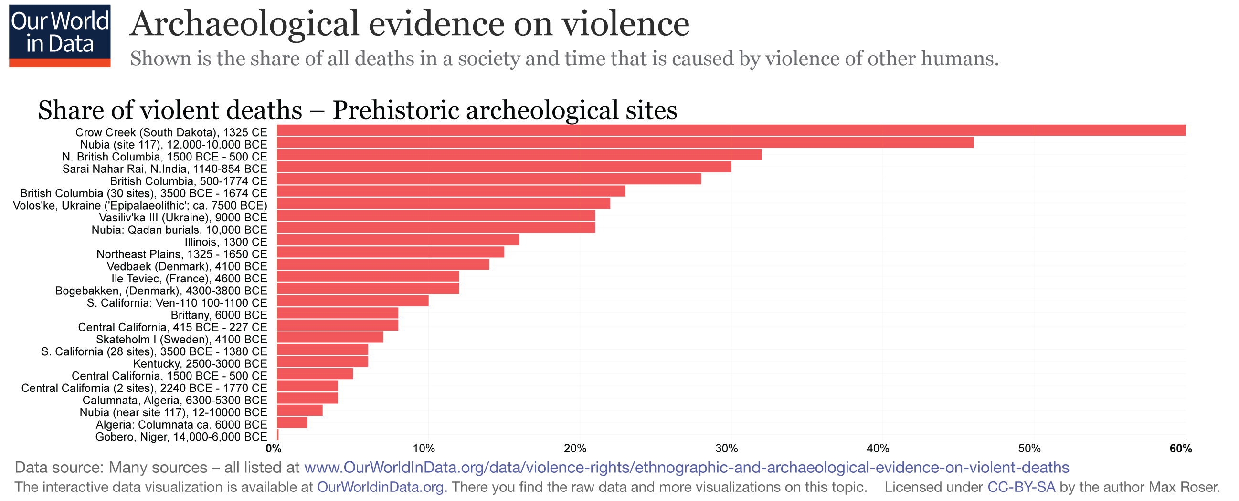
Conflict trends – Long term
Source: Roser, 2013.

Slide 6
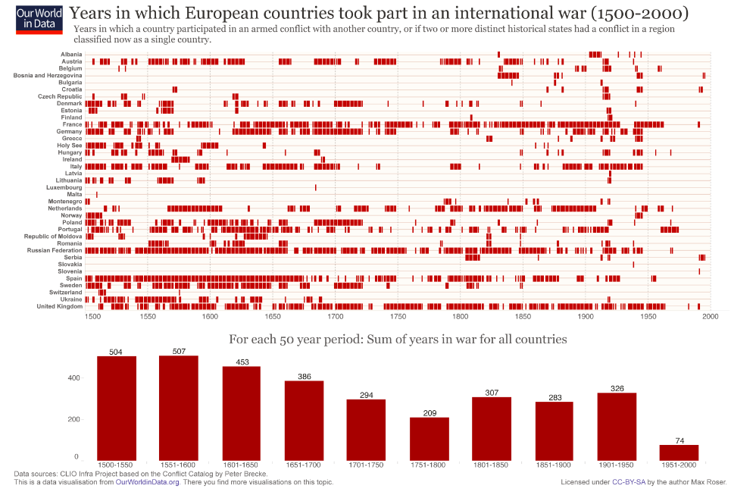
Conflict trends – Long term
Source: Max Roser, Joe Hasell, Bastian Herre and Bobbie Macdonald, 2016.

Slide 7
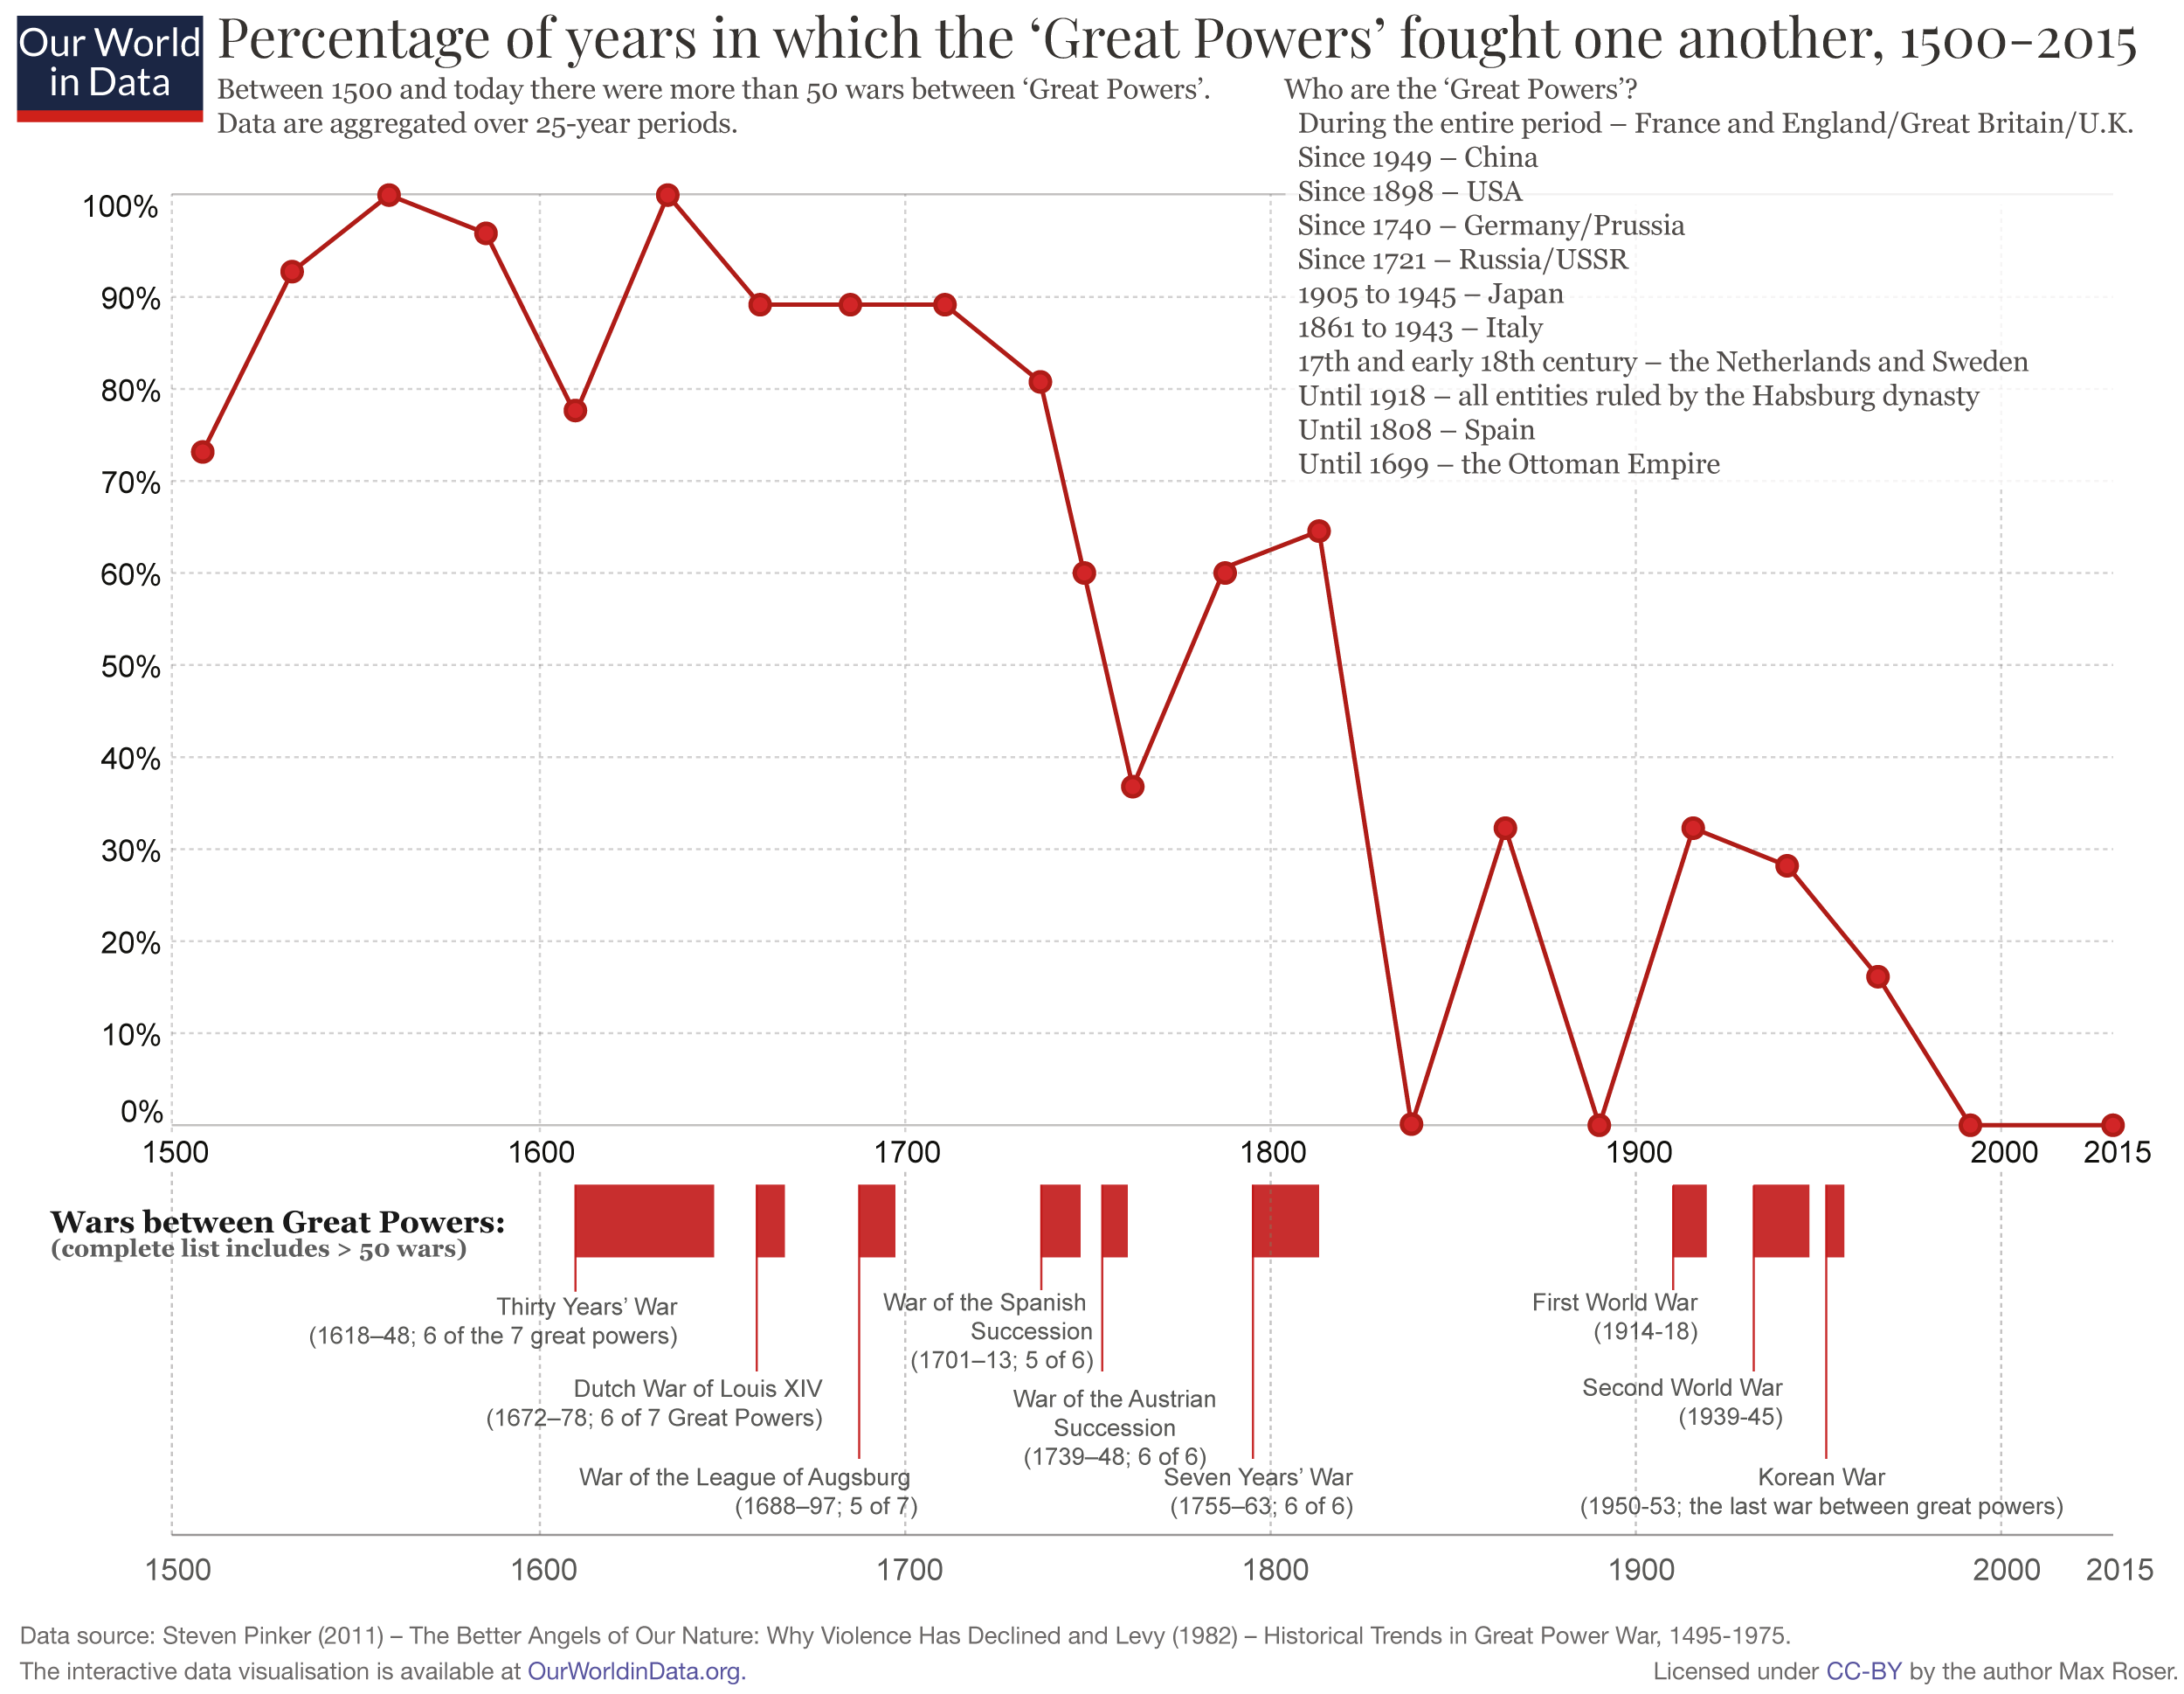
Conflict trends – Long term
Source: Max Roser, Joe Hasell, Bastian Herre and Bobbie Macdonald, 2016.

Slide 8
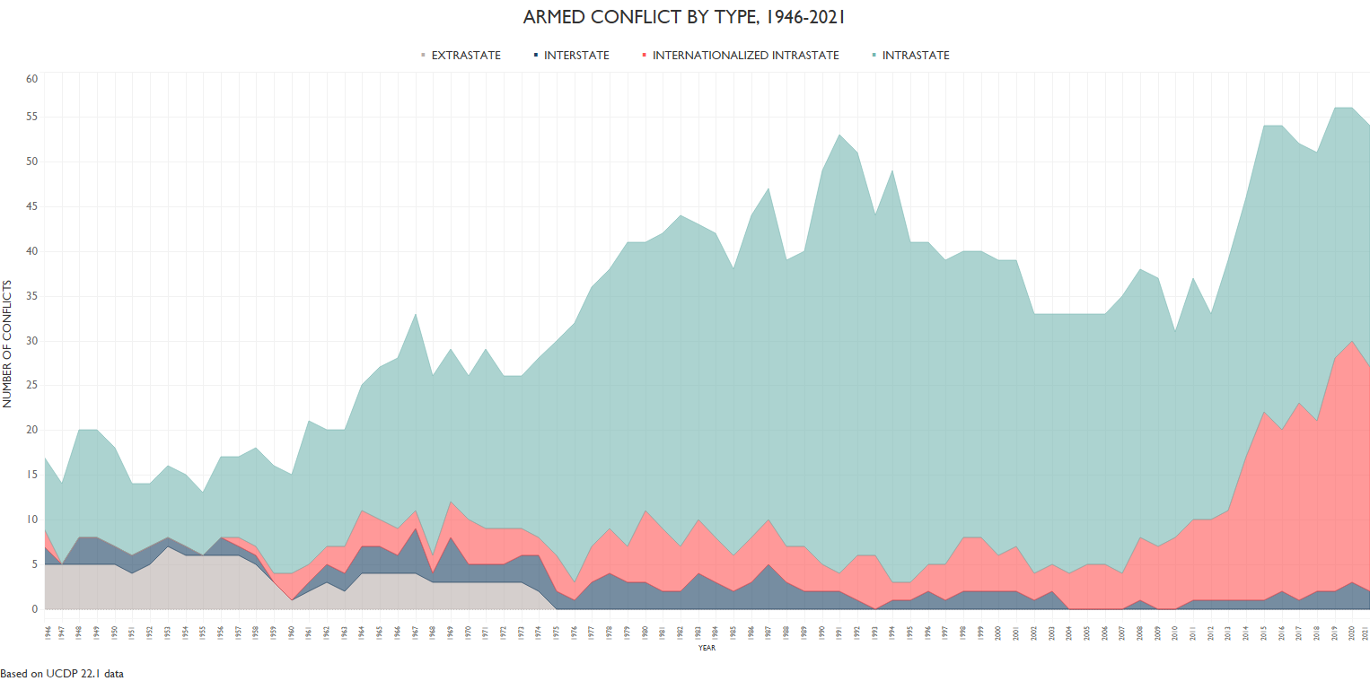
Conflict trends – Medium- and short-term trends
^{[i]} Armed conflict in this case defined as at least 25 battle-related deaths per calendar years in one of the conflict’s dyads. Source: Uppsala Conflict Database, 2022.

Slide 9
Conflict types
The typology varies widely depending on the author, organization, region, country, etc.
Few examples:
1. International Humanitarian Law:
International armed conflict
Internationalized armed conflict
Non-international conflict
2. Uppsala Conflict Database's typology
Extrastate
Interstate
Intrastate
Internationalized intrastate
(Colonial wars)
3. Ramsbotham, Woodhouse, and Miall’s (2016) typology:
Interstate
Non-interstate: revolution/ideology; identity/secession; economic/resource

Slide 10
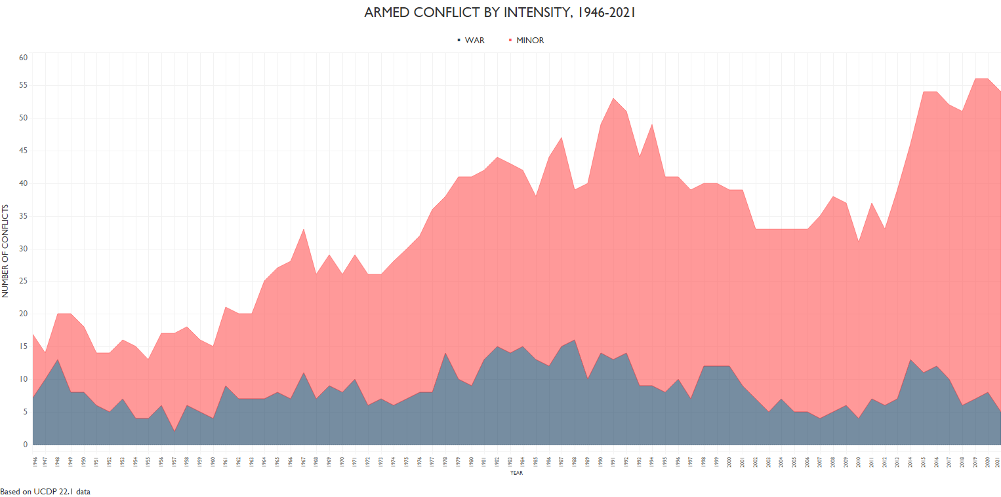
Conflict trends – Intensity
^{[i]} Armed conflict in this case defined as at least 25 battle-related deaths per calendar years in one of the conflict’s dyads. Source: Uppsala Conflict Database, 2022.

Slide 11
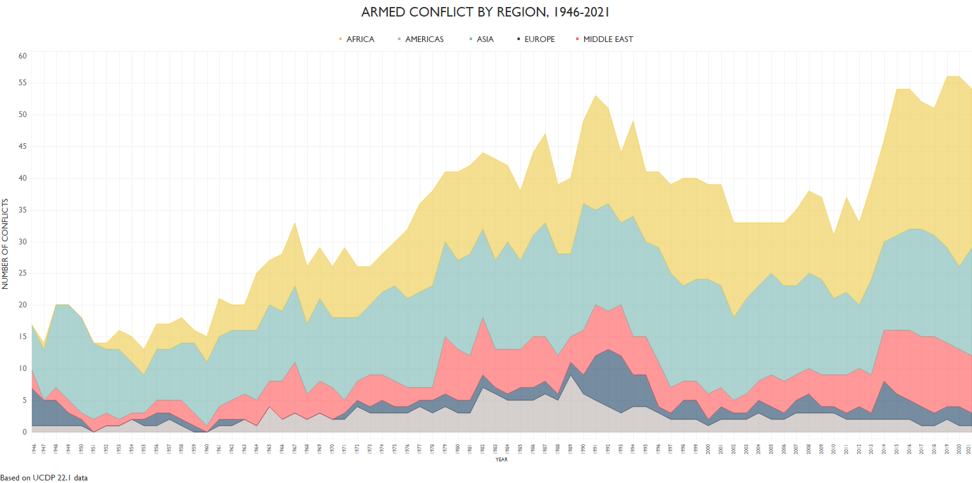
Conflict Zones
^{[i]} Armed conflict in this case defined as at least 25 battle-related deaths per calendar years in one of the conflict’s dyads. Source: Uppsala Conflict Database, 2022.

Slide 12
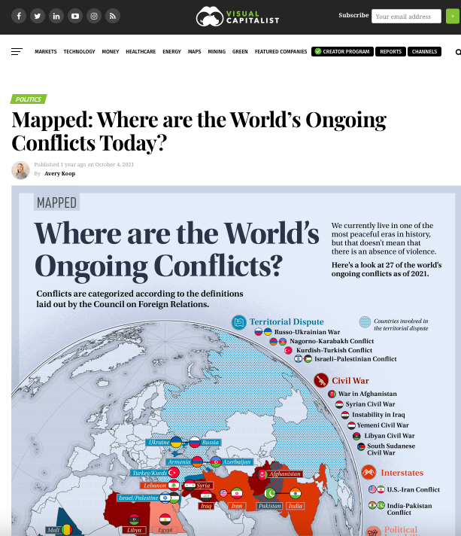
Conflict Zones
Regionalization of conflict dynamics: The emergence of complex regional conflict zones
Spillover effects
Example: Syria undermines the stability of Iraq or Iraq undermines the stability of Syria?
Other examples?
Most affected regions?
Visit this website for comprehensive regional outlooks.

Slide 13
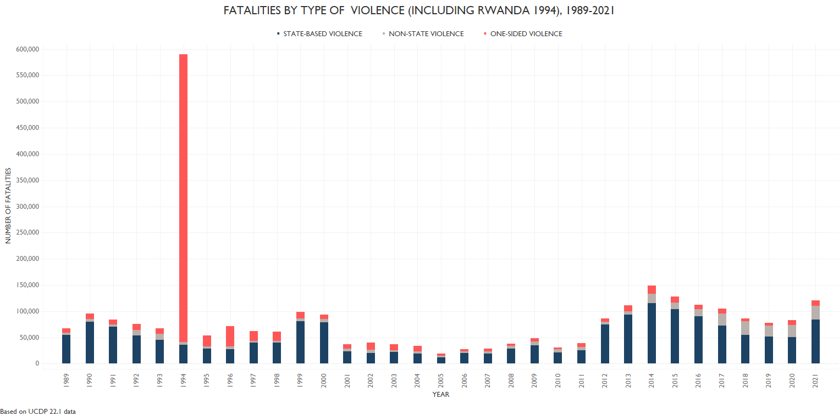
Consequences: Battle related deaths
Source: Uppsala Conflict Database, 2022.

Slide 14
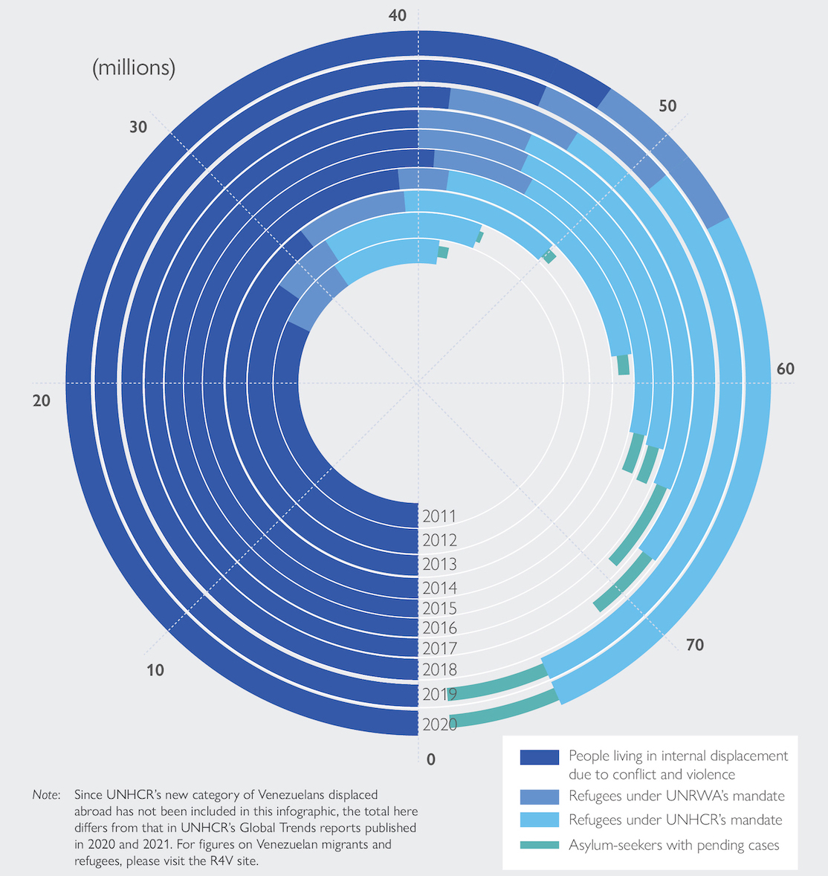
Consequences: Displacement
Global Trends of Total Forced Displacement
(2011-2020)
Source: IOM, 2021.

Slide 15
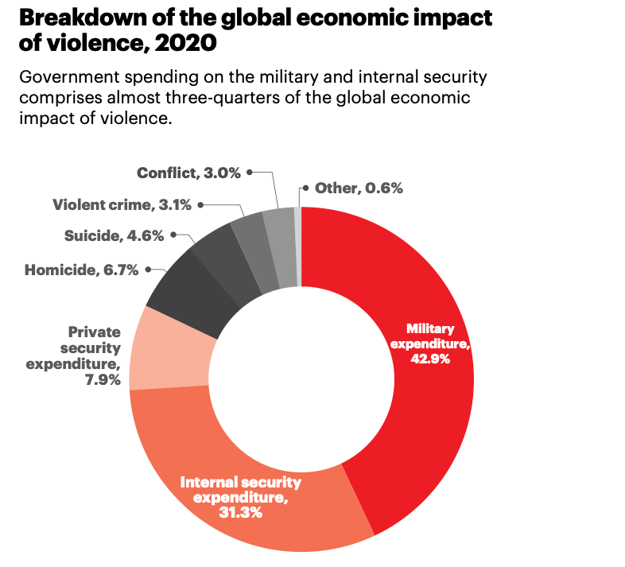
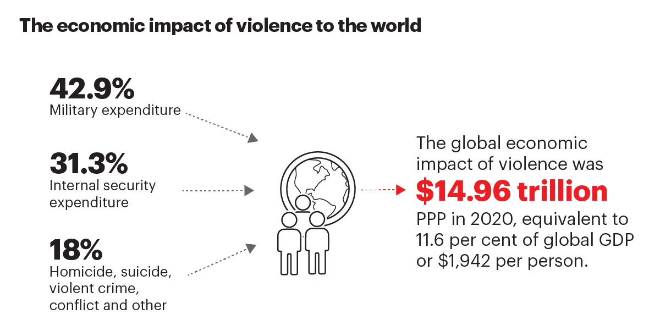
Consequences: Economic costs
Source: IEP, 2021.

Slide 16
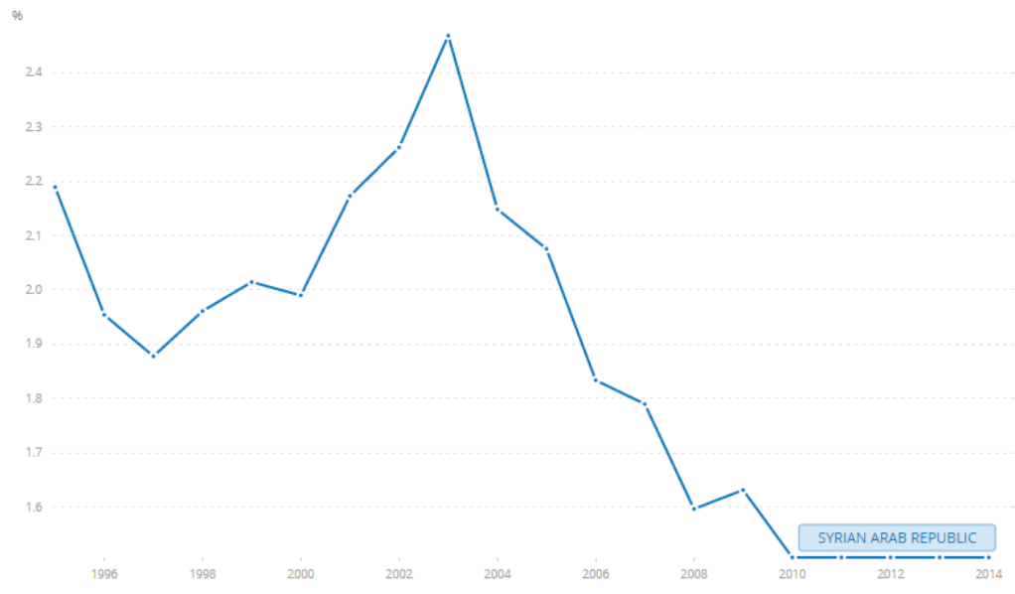
Consequences: Social costs
Health expenditure in Syria (Percentage of GDP)
Source: World Bank, 2022.

Slide 17
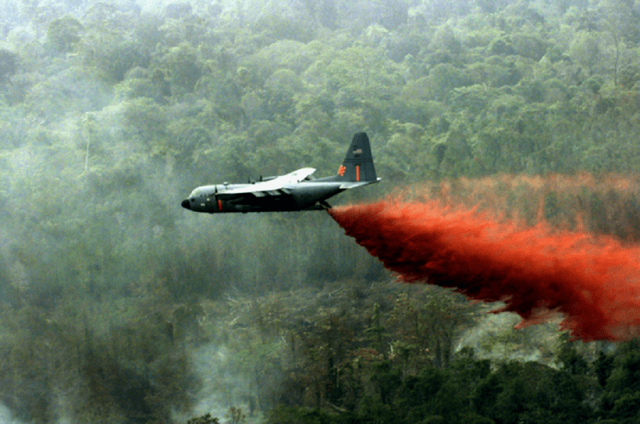
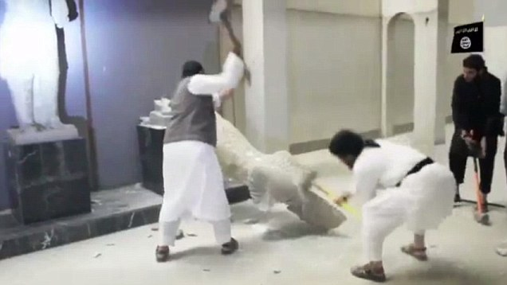
Consequences: Cultural and Environmental Costs
ISIS fanatics destroy museums as part of cultural ”cleansing”.
US plane drops agent orange during the Vietnam War.

Slide 18
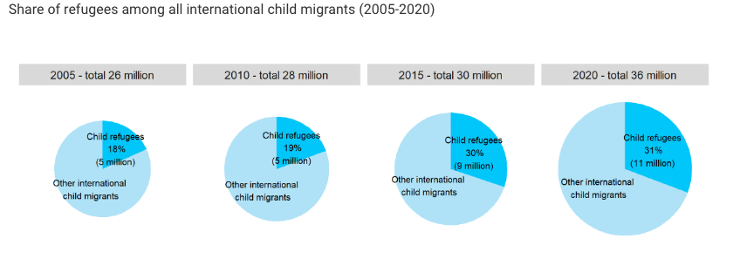
Consequences: Intergenerational costs
Source: UNICEF, 2021.

Slide 19
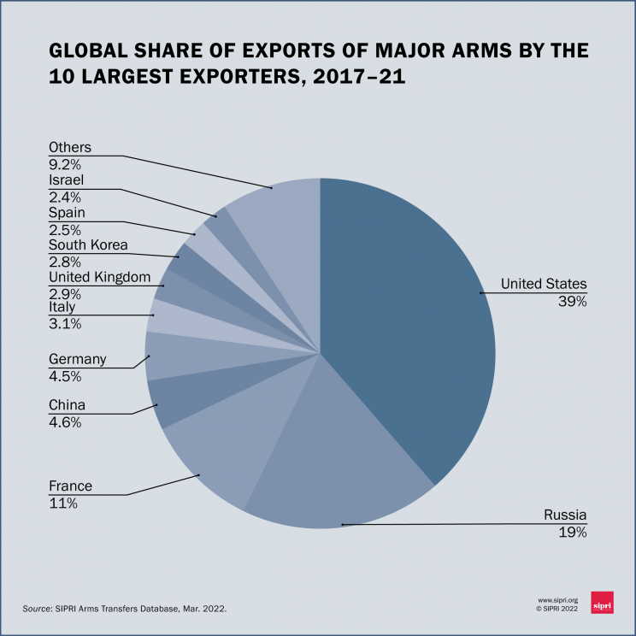
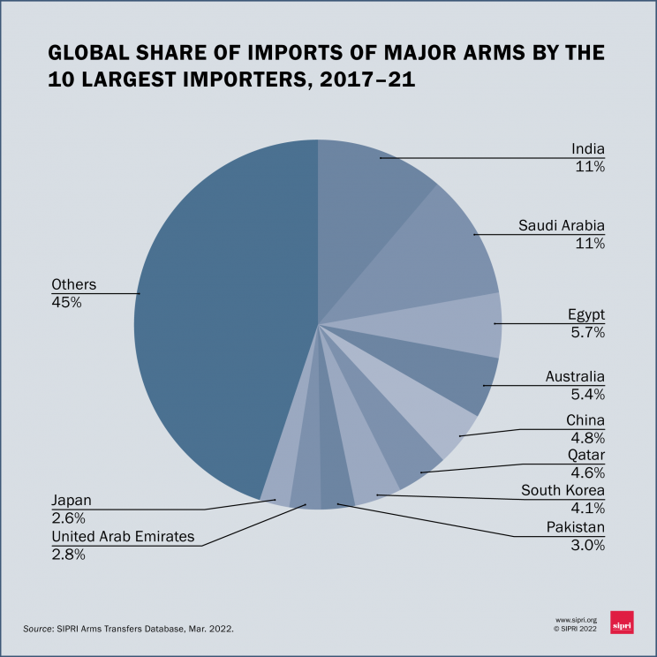
Conflict suppliers
Source: SIPRI, 2022.

Slide 20
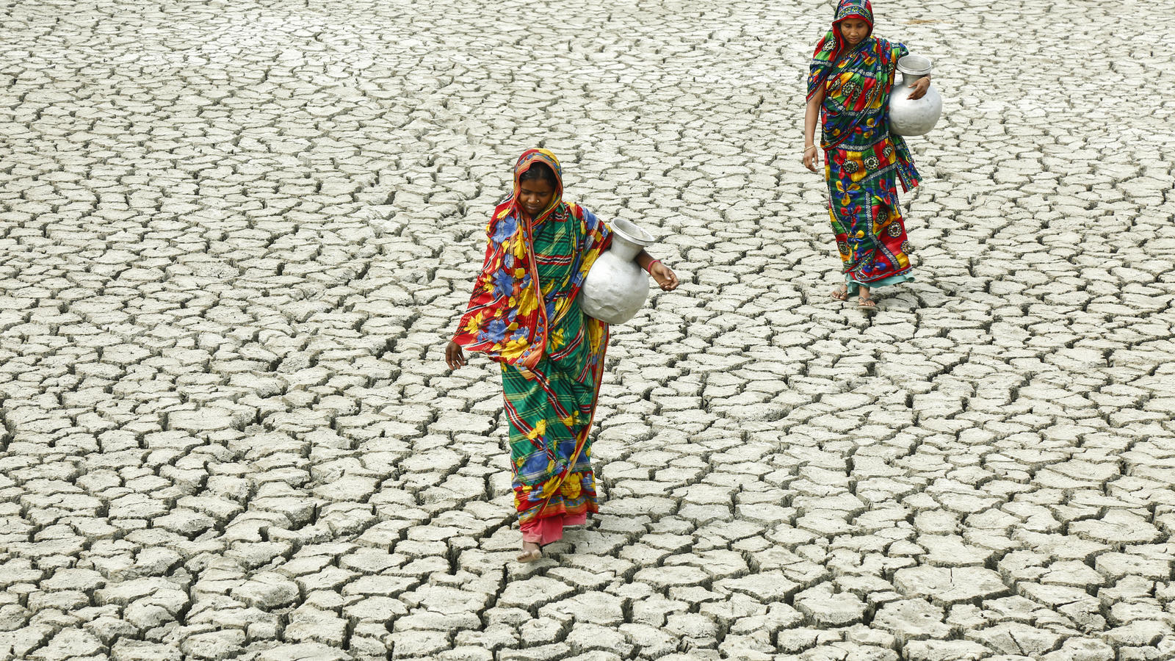
Future trends: Potential future causes
Generally, structural (systemic) change will generate conflicts.
It will include several factors:
– Polarity shifts – Global and regional dynamics
– Resource and environmental conflicts
– Conflicts caused by displacements
– Economic crises
– "Status traps" and its consequences
– Conflicts caused by nationalist and populist policies
– Pandemics(?)

Slide 21
Bibliography
Keeley, L. H. (1996). War Before Civilization: the Myth of the Peaceful Savage. Oxford University Press.
Beer, Francis. A. (1981). Peace Against War: The Ecology of International Violence. W. H. Freeman.
Ramsbotham, O., Woodhouse, T., & Miall, H. (2016). Contemporary conflict resolution: the prevention, management and transformation of deadly conflicts (4th ed.). Polity Press.
Internet sources are indicated in each case by a hyperlink.

Slide 22
Thank you for your
attention!

