Slide 1
SECURITY AND PEACE IN AN UNCERTAIN WORLD First module: Trends, theories and analytical frameworks
2. Security studies I. Zoltán Vörös, PhD Department of Political Science and International Studies University of Pécs

Slide 2
The following disclaimer shall be added to the inner pages of the publications and studies written by external independent bodies with support from the European Commission:
BG | Подкрепата на Европейската комисия за изготвянето на настоящата публикация не представлява одобрение на съдържанието, което отразява гледните точки само на авторите и не може да се търси отговорност от Комисията за всяка употреба, която може да бъде използвана за информацията, съдържаща се в нея.
CS | Podpora Evropské komise při tvorbě této publikace nepředstavuje souhlas s obsahem, který odráží pouze názory autorů, a Komise nemůže být zodpovědná za jakékoliv využití informací obsažených v této publikaci.
DA | Europa-Kommissionens støtte til produktionen af denne publikation udgør ikke en godkendelse af indholdet, som kun afspejler forfatternes egne synspunkter, og Kommissionen kan ikke holdes ansvarlig for den brug, der måtte blive gjort af de deri indeholdte oplysninger.
DE | Die Unterstützung der Europäischen Kommission für die Erstellung dieser Veröffentlichung stellt keine Billigung des Inhalts dar, welcher nur die Ansichten der Verfasser wiedergibt, und die Kommission kann nicht für eine etwaige Verwendung der darin enthaltenen Informationen haftbar gemacht werden.
EL | Η υποστήριξη της Ευρωπαϊκής Επιτροπής στην παραγωγή της παρούσας έκδοσης δεν συνιστά αποδοχή του περιεχομένου, το οποίο αντικατοπτρίζει αποκλειστικά τις απόψεις των συντακτών, και η Επιτροπή δεν μπορεί να αναλάβει την ευθύνη για οποιαδήποτε χρήση των πληροφοριών που περιέχονται σε αυτήν.
EN | The European Commission's support for the production of this publication does not constitute an endorsement of the contents, which reflect the views only of the authors, and the Commission cannot be held responsible for any use which may be made of the information contained therein.
ES | El apoyo de la Comisión Europea para la producción de esta publicación no constituye una aprobación del contenido, el cual refleja únicamente las opiniones de los autores, y la Comisión no se hace responsable del uso que pueda hacerse de la información contenida en la misma.
ET | Euroopa Komisjoni toetus käesoleva väljaande koostamisele ei tähenda väljaandes esitatud sisu kinnitamist. Väljaandes esitatud sisu peegeldab vaid autorite seisukohti. Euroopa Komisjon ei vastuta selles sisalduva teabe kasutamise eest.
FI | Euroopan komission tuki tämän julkaisun tuottamiseen ei tarkoita sitä, että sisältö, joka kuvastaa pelkästään tekijöiden näkemyksiä, saa kannatusta, eikä komissiota voida saattaa vastuuseen niiden sisältämien tietojen mahdollisesta käytöstä.
FR | Le soutien de la Commission européenne à la production de cette publication ne constitue pas une approbation du contenu, qui reflète uniquement le point de vue des auteurs, et la Commission ne peut pas être tenue responsable de toute utilisation qui pourrait être faite des informations qu’elle contient.
GA | Ní hionann tacaíocht an Choimisiúin Eorpaigh do tháirgeadh an fhoilseacháin seo agus formhuiniú ar ábhair an fhoilseacháin, lena léirítear tuairimí na n-údar amháin, agus ní féidir freagracht a chur ar an gCoimisiún as aon úsáid a d’fhéadfaí a bhaint as an bhfaisnéis atá ann.
HR | Potpora Europske komisije proizvodnji ove publikacije ne predstavlja potporu sadržaju koji odražava samo stavove autora i Komisija ne može biti odgovorna za uporabu sadržanih informacija.

Slide 3
HU | Az Európai Bizottság támogatása ezen kiadvány elkészítéséhez nem jelenti a tartalom jóváhagyását, amely kizárólag a szerzők álláspontját tükrözi, valamint a Bizottság nem tehető felelőssé ezen információk bárminemű felhasználásáért.
IT | Il sostegno della Commissione europea alla produzione di questa pubblicazione non costituisce un'approvazione del contenuto, che riflette esclusivamente il punto di vista degli autori, e la Commissione non può essere ritenuta responsabile per l'uso che può essere fatto delle informazioni ivi contenute.
LT | Europos Komisijos parama šio leidinio rengimui nereiškia pritarimo jo turiniui, kuriame pateikiama autorių nuomonė, todėl Europos Komisija negali būti laikoma atsakinga už informaciją panaudotą šiame leidinyje.
LV | Eiropas Komisijas atbalsts šīs publikācijas sagatavošanai nav uzskatāms par satura apstiprinājumu, kas atspoguļo tikai autoru viedokļus, un Komisija nevar būt atbildīga par tajā ietvertās informācijas jebkādu izmantošanu.
MT | L-appoġġ tal-Kummissjoni Ewropea għall-produzzjoni ta’ din il-pubblikazzjoni ma jikkostitwixxix approvazzjoni tal-kontenut, li jirrifletti biss il-fehmiet tal-awturi, u l-Kummissjoni ma tistax tinżamm responsabbli għal kwalunkwe użu li jista’ jsir mill-informazzjoni li tinsab fiha.
NL | De steun van de Europese Commissie voor de productie van deze publicatie houdt geen goedkeuring van de inhoud in. De inhoud geeft de standpunten van de auteurs weer en de Commissie kan niet aansprakelijk worden gesteld voor het gebruik dat eventueel wordt gemaakt van de daarin opgenomen informatie.
PL | Wsparcie Komisji Europejskiej dla produkcji tej publikacji nie stanowi poparcia dla treści, które odzwierciedlają jedynie poglądy autorów, a Komisja nie może zostać pociagnięta do odpowiedzialności za jakiekolwiek wykorzystanie informacji w niej zawartych.
PT | O apoio da Comissão Europeia à produção desta publicação não constitui um aval do seu conteúdo, que reflete unicamente o ponto de vista dos autores, e a Comissão não pode ser considerada responsável por eventuais utilizações que possam ser feitas com as informações nela contidas.
RO | Sprijinul acordat de Comisia Europeană pentru elaborarea acestei publicații nu constituie o aprobare a conținutului, care reflectă doar opiniile autorilor, iar Comisia nu poate fi trasă la răspundere pentru orice utilizare a informațiilor conținute în aceasta.
SK | Podpora Európskej komisie na výrobu tejto publikácie nepredstavuje súhlas s obsahom, ktorý odráža len názory autorov, a Komisia nemôže byť zodpovedná za prípadné použitie informácií, ktoré sú v nej obsiahnuté.
SL | Podpora Evropske komisije za pripravo te publikacije ne pomeni potrditve vsebine, ki izraža le mnenja avtorjev, in Komisija ne more biti odgovorna za kakršno koli uporabo informacij, ki jih vsebuje.
SV | Europeiska Kommissionens stöd åt framställningen av detta dokument utgör inte ett godkännande av dess innehåll, vilket endast återspeglar upphovsmännens åsikter, och Kommissionen kan inte hållas ansvarigt för någon användning av informationen i det.

Slide 4
Introduction
Security is everywhere around us – An always important topic.
But what is security?
Essentially contested concept? – Security undoubtedly means different things to different people.
Involves the alleviation of threats to cherished values.
Security is unaviodably political term.
And security studies can never be only intellectual, hyptothetical, since because it is stimulated by achieving security for real people in real places!
Interpreting past, understanding present, influencing future
Security is a trump-card in several cases!
Who gets to decide what security means?

Slide 5
What is Security?
How this field evolved?
Great power politics
Technology
Key events
Internal dynamics of academic debates
Institutionalization
So: material power, knowledge, history, social constructions and wealth, organizational dynamics.

Slide 6
What is Security?
’Golden Age’: 1950s, 1960s
Academic concepts outside governments
The four S’s of Security Studies
Focused on states: they were considered to be both the most important agents and referents of security in international politics.
Was about strategy: intellectual and practical concerns about the ways to handle threat (and use military force)
It aspired to be scientific: searching authentic, objective knowledge
Preserving status quo: Avoiding radical and revolutionary changes
Barry Buzan in 1983
Security is not only for states – it is related to all human collectivities
Questioning the use of military force

Slide 7
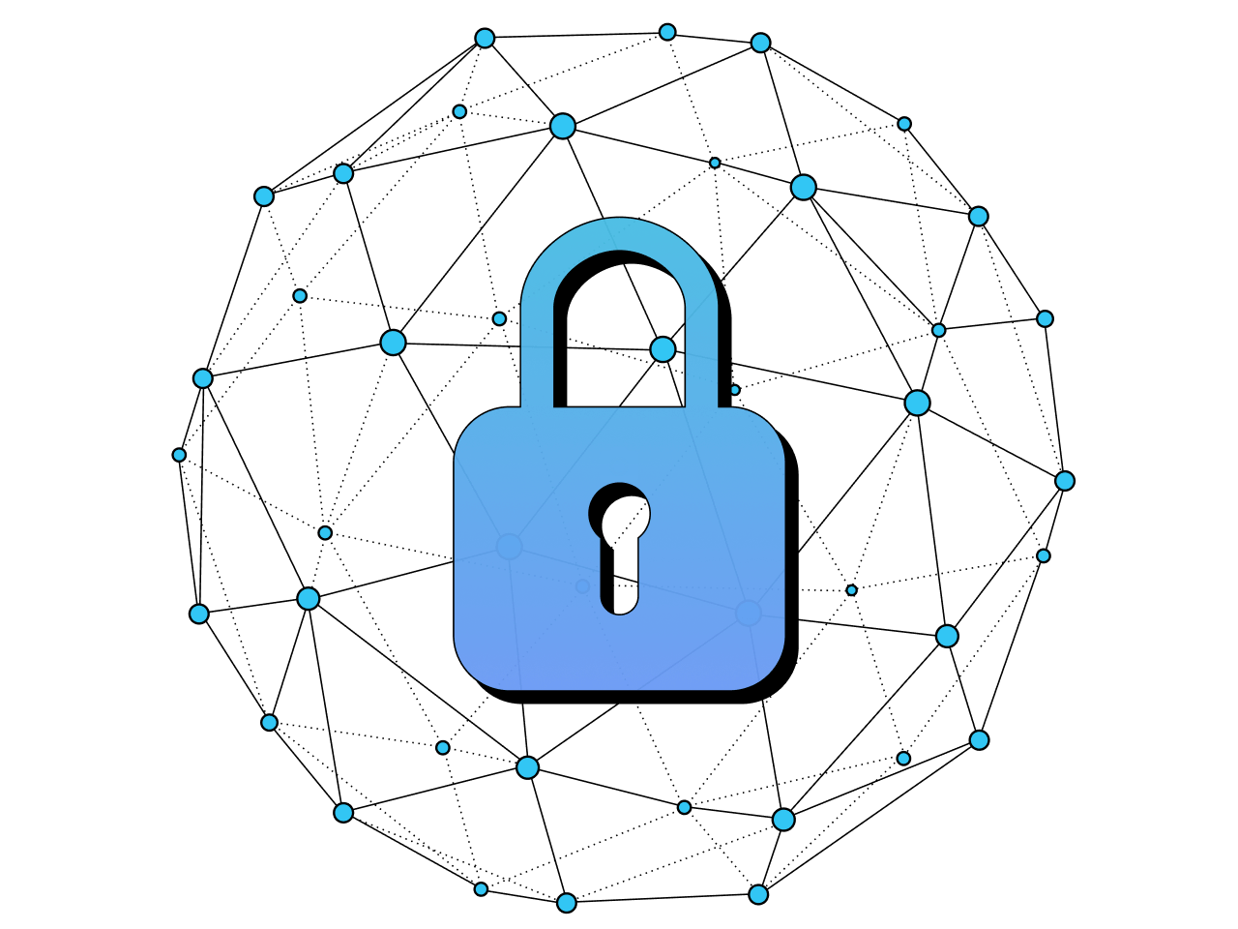
What is Security?
Four fundemental questions about Security Studies
What is security?
Whose security are we talking about?
What counts as a security issue?
How can security be achieved?

Slide 8
What is Security?
The alleviation of threats to cherished values.
Especially those, which threaten the survival of a particular referent object in the future.
Defense is a post factum action. Happens after the attack occured.
There are two different philosophical understandings of security.
First: Security is virtually synonymus with the accumulation of power. So, the more power actors can accumulate (money, weapons, army, territory, etc.), the more secure they will be.
Second: Security is based on cooperation. Security is understood as a relationship between different actors rather than a commodity. (Of course the relation can be positive and negative as well)
Discussion: Nuclear WMD in Iran

Slide 9
Approaches to Security
De facto approach
A situation without threat
The activation of danger is not expected
Sense, perception
Sense of security of the society
Can be manipulated – over and underestimating, exaggerating risk (on purpose)
If a group feels threatened: reaction is needed from politics
Institutional, legal approach
System of guarantees (secret service, infrastructure, planning, international organizations)
→ helping security.

Slide 10
Widening Scope
The concept is meaningless without something or somebody to secure. People or state?
1. For long decades the answer was: the state
The period of state security
2. But if the people are the subject of security studies, then
Which humans to prioritize?
3. Third approach: Society
4. Fourth: All levels of social groups, from independent human to international system
5. Fifth: Planet Earth

Slide 11
Traditional Subjects
So, according to a popular and accepted view, the subject of the security:
The sovereignty of the state
The life of citizens
National interests and property
If any of this is in danger, the country is in danger.
Discussion: The life of citizens – Tools and policies of a state

Slide 12
Complexity
Security is more complex than ever.
At the early stages, there were two security threats:
Enemy
Natural disaster.
Today:
Interdependence, system-like threats.
The threats are connected

Slide 13
Sectoral Approach
The sectoral theory of security was introduced by Barry Buzan, a member of the Copenhagen School, and his co-authors in their 1983 work "People, States and Fear: The National Security Problem in International Relations".
Military sector: the building and maintaining of a military offensive and defensive force against both internal and external armed threats. The main objective of the state is to protect its territory (land, water, airspace) and its population.
states dissatisfied with the status quo
terrorist organisations
organised criminal groups

Slide 14
Sectoral Approach
Economic: Determined by the state's access to raw materials and energy, its debt situation, the spill-over of international recessions, the development of the state's fiscal, growth and inflation indicators.
economic crises (local, regional, global)
energy dependence
economic sanctions (boycotts, embargoes)
Political: The object of protection is primarily the sovereignty of the state, and therefore the concept of political security refers to the internal stability of the country, the functioning of its institutions and the ability of the state to carry out its functions without disruption, on the one hand, and its consolidated external relations and international position free from threats, on the other.
influence of other state(s)
extremist political forces
lack of a minimum internal political consensus
inability of basic state institutions to function

Slide 15
Sectoral Approach
Social: Language, culture means the sustainability of national traditions, values, religious-national identity, peaceful coexistence and social peace between nations, nationalities, ethnic groups, religious denominations living in the country.
Migration
national, ethnic, religious hostilities
extreme social disparities
Environmental: Determined by a country's geography, geography, climate, earthquake hazards, human behaviour that threatens the environment.
Floods, tsunamis
Earthquakes
volcanic eruptions
climate change
water scarcity

Slide 16
Further Sectors
Human Security: Closely related to the concept of social security, the subject of security is no longer the state but the person, the individual. The concept was laid down in the 1994 UNDP Human Development Report. It means the protection of the individual (life, physical integrity, human dignity) and the guarantee of the basic conditions for a decent environment and quality of life.
epidemics
hunger
water scarcity
environmental pollution
unemployment
drugs
crime,
mass understanding of freedoms

Slide 17
Further Sectors
Cybersecurity: the set of tools, policies, security concepts and activities aimed at protecting the computing environment, the assets and systems of the organisations and users that use it.
cyber warfare, state-sponsored cyber attacks
cybercrime (hacker attacks, e.g. against individuals' social profiles, email accounts)
proliferation of cyber weapons

Slide 18
Scales
Danger, risk - ALWAYS THERE!
It is always there, existing (Environmental, natural, etc.)
A situation a state have to be ready for, if it escaletes.
Can prevent, control. Risk in this: failure in handling the situation.
The political level is the one to decide: using force or diplomatic tools.
Crisis
Activation of danger, still reversible.
Outcome is not clear: escalation or solution.
Threat
Clear, articulated will from a group/state/person to solve issues by using force.
Conflict
Clash.

Slide 19
Bibliography
Storey, David: Territory: The Claiming of Space. Routledge, London, 2011. [2nd ed.] ISBN: 9780415575508
Williams, P.D. and MacDonald, M. (2018) ‘An introduction to security studies’. In Security Studies: An introduction, pp. 1-14.
Human Development Report, 1994 https://hdr.undp.org/content/human-development-report-1994

Slide 20
Thank you for your
attention!

