Slide 1
SECURITY AND PEACE IN AN UNCERTAIN WORLD First module: Trends, theories and analytical frameworks
4. The strategic dimensions of peace perceptions Péter Kacziba, PhD Department of Political Science and International Studies University of Pécs

Slide 2
The following disclaimer shall be added to the inner pages of the publications and studies written by external independent bodies with support from the European Commission:
BG | Подкрепата на Европейската комисия за изготвянето на настоящата публикация не представлява одобрение на съдържанието, което отразява гледните точки само на авторите и не може да се търси отговорност от Комисията за всяка употреба, която може да бъде използвана за информацията, съдържаща се в нея.
CS | Podpora Evropské komise při tvorbě této publikace nepředstavuje souhlas s obsahem, který odráží pouze názory autorů, a Komise nemůže být zodpovědná za jakékoliv využití informací obsažených v této publikaci.
DA | Europa-Kommissionens støtte til produktionen af denne publikation udgør ikke en godkendelse af indholdet, som kun afspejler forfatternes egne synspunkter, og Kommissionen kan ikke holdes ansvarlig for den brug, der måtte blive gjort af de deri indeholdte oplysninger.
DE | Die Unterstützung der Europäischen Kommission für die Erstellung dieser Veröffentlichung stellt keine Billigung des Inhalts dar, welcher nur die Ansichten der Verfasser wiedergibt, und die Kommission kann nicht für eine etwaige Verwendung der darin enthaltenen Informationen haftbar gemacht werden.
EL | Η υποστήριξη της Ευρωπαϊκής Επιτροπής στην παραγωγή της παρούσας έκδοσης δεν συνιστά αποδοχή του περιεχομένου, το οποίο αντικατοπτρίζει αποκλειστικά τις απόψεις των συντακτών, και η Επιτροπή δεν μπορεί να αναλάβει την ευθύνη για οποιαδήποτε χρήση των πληροφοριών που περιέχονται σε αυτήν.
EN | The European Commission's support for the production of this publication does not constitute an endorsement of the contents, which reflect the views only of the authors, and the Commission cannot be held responsible for any use which may be made of the information contained therein.
ES | El apoyo de la Comisión Europea para la producción de esta publicación no constituye una aprobación del contenido, el cual refleja únicamente las opiniones de los autores, y la Comisión no se hace responsable del uso que pueda hacerse de la información contenida en la misma.
ET | Euroopa Komisjoni toetus käesoleva väljaande koostamisele ei tähenda väljaandes esitatud sisu kinnitamist. Väljaandes esitatud sisu peegeldab vaid autorite seisukohti. Euroopa Komisjon ei vastuta selles sisalduva teabe kasutamise eest.
FI | Euroopan komission tuki tämän julkaisun tuottamiseen ei tarkoita sitä, että sisältö, joka kuvastaa pelkästään tekijöiden näkemyksiä, saa kannatusta, eikä komissiota voida saattaa vastuuseen niiden sisältämien tietojen mahdollisesta käytöstä.
FR | Le soutien de la Commission européenne à la production de cette publication ne constitue pas une approbation du contenu, qui reflète uniquement le point de vue des auteurs, et la Commission ne peut pas être tenue responsable de toute utilisation qui pourrait être faite des informations qu’elle contient.
GA | Ní hionann tacaíocht an Choimisiúin Eorpaigh do tháirgeadh an fhoilseacháin seo agus formhuiniú ar ábhair an fhoilseacháin, lena léirítear tuairimí na n-údar amháin, agus ní féidir freagracht a chur ar an gCoimisiún as aon úsáid a d’fhéadfaí a bhaint as an bhfaisnéis atá ann.
HR | Potpora Europske komisije proizvodnji ove publikacije ne predstavlja potporu sadržaju koji odražava samo stavove autora i Komisija ne može biti odgovorna za uporabu sadržanih informacija.

Slide 3
HU | Az Európai Bizottság támogatása ezen kiadvány elkészítéséhez nem jelenti a tartalom jóváhagyását, amely kizárólag a szerzők álláspontját tükrözi, valamint a Bizottság nem tehető felelőssé ezen információk bárminemű felhasználásáért.
IT | Il sostegno della Commissione europea alla produzione di questa pubblicazione non costituisce un'approvazione del contenuto, che riflette esclusivamente il punto di vista degli autori, e la Commissione non può essere ritenuta responsabile per l'uso che può essere fatto delle informazioni ivi contenute.
LT | Europos Komisijos parama šio leidinio rengimui nereiškia pritarimo jo turiniui, kuriame pateikiama autorių nuomonė, todėl Europos Komisija negali būti laikoma atsakinga už informaciją panaudotą šiame leidinyje.
LV | Eiropas Komisijas atbalsts šīs publikācijas sagatavošanai nav uzskatāms par satura apstiprinājumu, kas atspoguļo tikai autoru viedokļus, un Komisija nevar būt atbildīga par tajā ietvertās informācijas jebkādu izmantošanu.
MT | L-appoġġ tal-Kummissjoni Ewropea għall-produzzjoni ta’ din il-pubblikazzjoni ma jikkostitwixxix approvazzjoni tal-kontenut, li jirrifletti biss il-fehmiet tal-awturi, u l-Kummissjoni ma tistax tinżamm responsabbli għal kwalunkwe użu li jista’ jsir mill-informazzjoni li tinsab fiha.
NL | De steun van de Europese Commissie voor de productie van deze publicatie houdt geen goedkeuring van de inhoud in. De inhoud geeft de standpunten van de auteurs weer en de Commissie kan niet aansprakelijk worden gesteld voor het gebruik dat eventueel wordt gemaakt van de daarin opgenomen informatie.
PL | Wsparcie Komisji Europejskiej dla produkcji tej publikacji nie stanowi poparcia dla treści, które odzwierciedlają jedynie poglądy autorów, a Komisja nie może zostać pociagnięta do odpowiedzialności za jakiekolwiek wykorzystanie informacji w niej zawartych.
PT | O apoio da Comissão Europeia à produção desta publicação não constitui um aval do seu conteúdo, que reflete unicamente o ponto de vista dos autores, e a Comissão não pode ser considerada responsável por eventuais utilizações que possam ser feitas com as informações nela contidas.
RO | Sprijinul acordat de Comisia Europeană pentru elaborarea acestei publicații nu constituie o aprobare a conținutului, care reflectă doar opiniile autorilor, iar Comisia nu poate fi trasă la răspundere pentru orice utilizare a informațiilor conținute în aceasta.
SK | Podpora Európskej komisie na výrobu tejto publikácie nepredstavuje súhlas s obsahom, ktorý odráža len názory autorov, a Komisia nemôže byť zodpovedná za prípadné použitie informácií, ktoré sú v nej obsiahnuté.
SL | Podpora Evropske komisije za pripravo te publikacije ne pomeni potrditve vsebine, ki izraža le mnenja avtorjev, in Komisija ne more biti odgovorna za kakršno koli uporabo informacij, ki jih vsebuje.
SV | Europeiska Kommissionens stöd åt framställningen av detta dokument utgör inte ett godkännande av dess innehåll, vilket endast återspeglar upphovsmännens åsikter, och Kommissionen kan inte hållas ansvarigt för någon användning av informationen i det.

Slide 4
Peace systems and World orders
The evolution of attempts to create a peaceful postwar international order
Source: Kalevi J. Holsti: Peace and War. Armed Conflicts and the International order 1648-1989. Cambridge University Press, Cambridge, 1991.

Slide 5
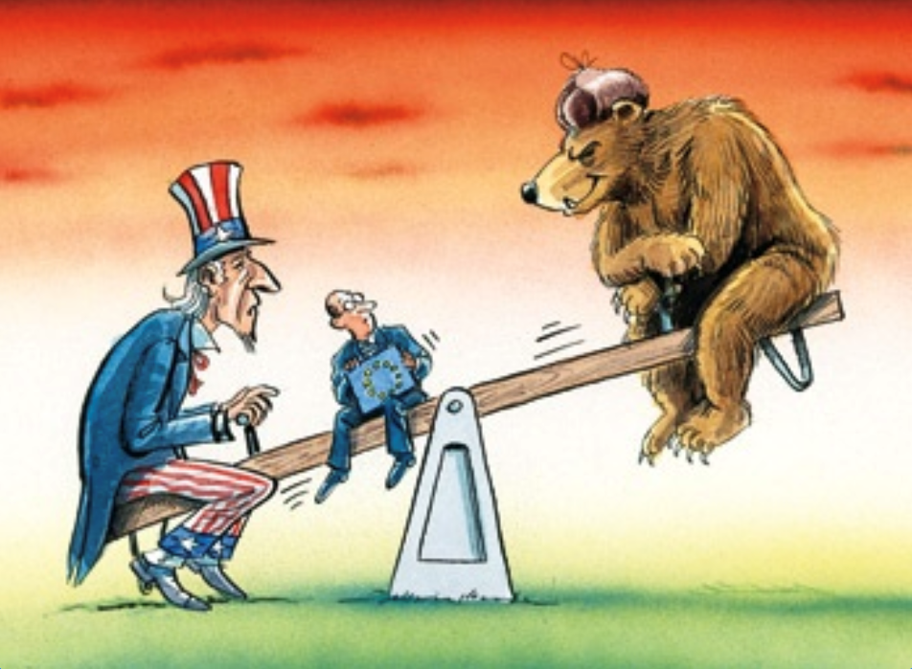
Realist view of Peace
For realists, security is the most important and peace is the consequence of security.
In general, security and peace is created by Balance of Power.
Human nature is bad and power struggle leads to war between states.
Balance of power creates temporary peace.
Universal peace is unrealizable because the balance of power often shifts and creates disorder.
Balance of power shifts because the defeated countries always wish to restore their freedom of power -> victor's peace: peace is always defined by the victorious powers.
Realists define peace as absence of war -> negative peace

Slide 6
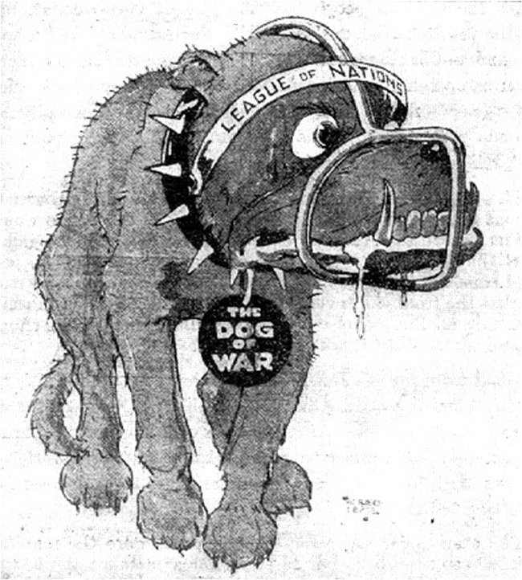
Liberal view of Peace
For liberals, peace is one of the most important issue.
What is peace, what creates it, how to achieve it, how to maintain it, how to rebuild it?
Human nature is good, therefore it can create peace.
But how to achieve peace?
1. By norms, cooperation, legal framework and collective institutions -> e.g. League of Nations, United Nations, NATO etc.
Collective supranational institutions can create and maintain peace by collective security.
Collective security is a form of threat (balance of threat).

Slide 7
Liberal view of Peace
2. Peace can be restored and maintained by form of governance -> democratic peace theory.
Monadic peace theory: democracies are more peaceful in general.
Dyadic peace theory: democracies do not fight one another.
Systemic peace theory: democracies are more peaceful = "zones of peace" could be extended by democratization.
Systemic peace theory evolved at the end of 1990s -> attempt to justify the US' democracy export.
Wars between democracies and non-democracies, 1816-2005
Source: Rummel, Rudolph J.: Death by Government. Transaction Publishers, New Brunswick, 2009, 2.

Slide 8
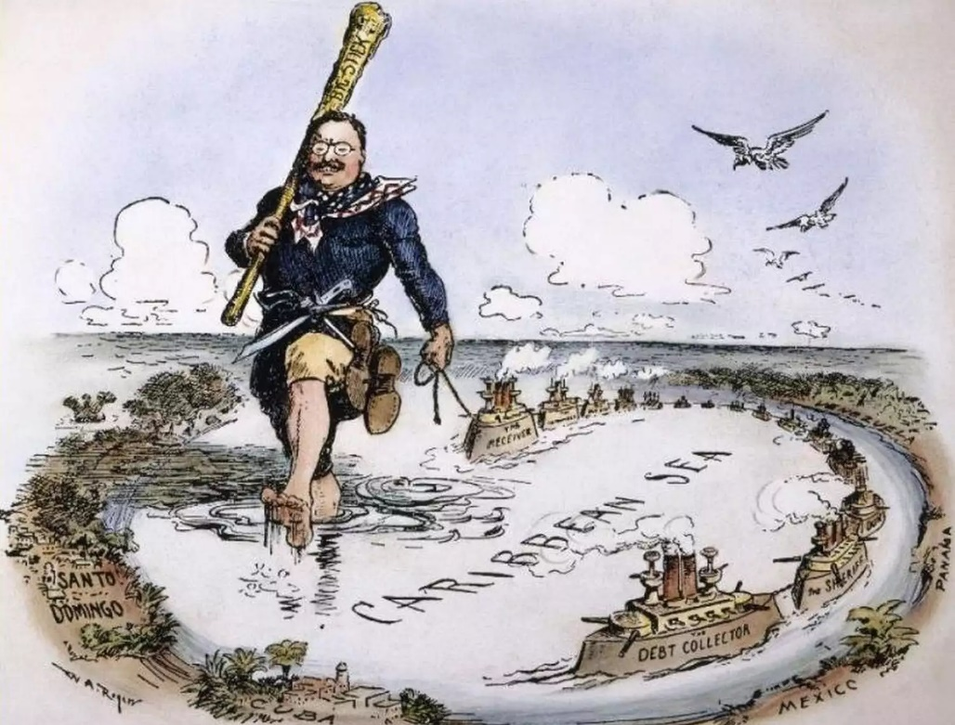
Liberal view of Peace
3. Free market economy creates peace among capitalist countries -> interdependency or capitalist/economic peace theory.
Just another interpretation of democratic peace theory.
Countries with free market economies do not fight one another because they would lose economic stakes.
The nature of capitalism maintains the peace among capitalist states.
Not worth to fight war.
Assumes that the promotion of free market economy is the promotion of peace.
Dollar diplomacy vs. capitalist peace theory

Slide 9
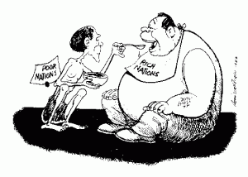
Radical view of Peace
Classical beliefs: capitalism and imperialism creates class struggle, class struggle leads to revolution but after war, communism leads to universal peace.
Universal peace can be achieved in the absence of capitalist exploitation when state borders are replaced by communism and when classless society is developed -> classless peace
Dependency theorists: peace can not be achieved in dependent economic or political relations.
Peace, created and maintained by hegemons, is not always considered to be "peace" by exploited countries.
Why? Because they are poor, exploited, have lower life expectancy, lower living standard, environmental problems etc.
In capitalist systems, only negative peace can be achieved.

Slide 10
Constructivist view of Peace
Accepts some concepts from the previous theories.
From realists:
Victor's peace -> peace is defined by the identities and norms of its creators.
BUT: A peace can not be maintained if the terms of peace do not represent the identities and norms of the concerned parties.
From radicals:
Peace defined by the hegemon is "peace" only for the hegemon.
From liberals:
Collective security can maintain peace among those who accept its role.
The common acceptance of norms gives power for collective security.
Constructivists believe that peace is a concept which is defined by concerned parties not by outside powers or experts.
Local leadership and participation

Slide 11
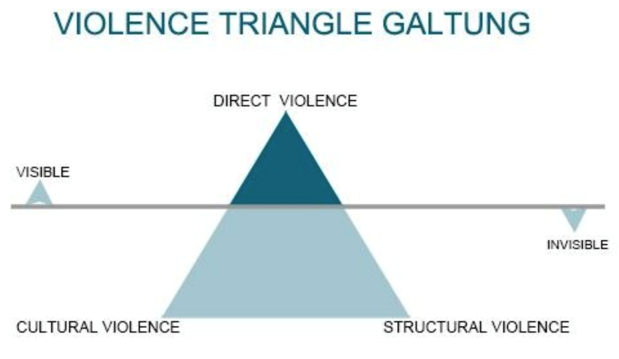
Peace as defined by conflict and peace studies: Johan Galtung
In the 1960s, Johan Galtung developed the concept of triangle of violence.
Structural violence is built into the structures of society which appears as unequal power; unequal life chances; unequal distribution of resources; or unequal distribution of power to decide over distribution of resources etc.
Cultural violence is the collection of techniques that justify, legitimize, promote, or intentionally hide aspects structural and direct violence. (e.g. Climate change denial)
Galtung introduced the terms of
negative peace: Absence of direct violence.
and positive peace: Absence of structural violence -> idealistic approach

Slide 12
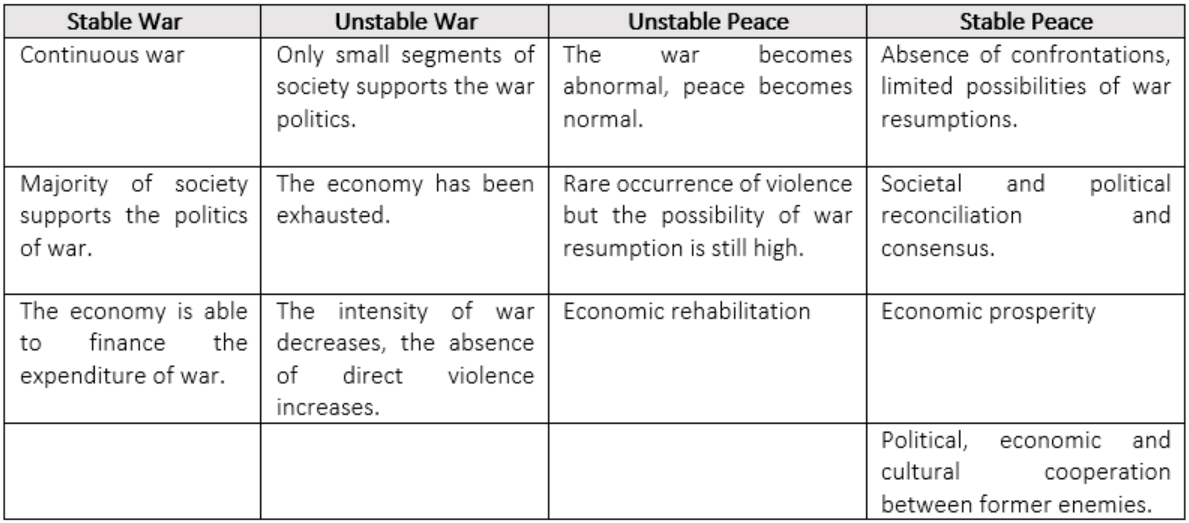
Peace as defined by conflict and peace studies: Kenneth Boulding
Source: Kenneth E. Boulding: Stable Peace. University of Texas Press, 1978.

Slide 13
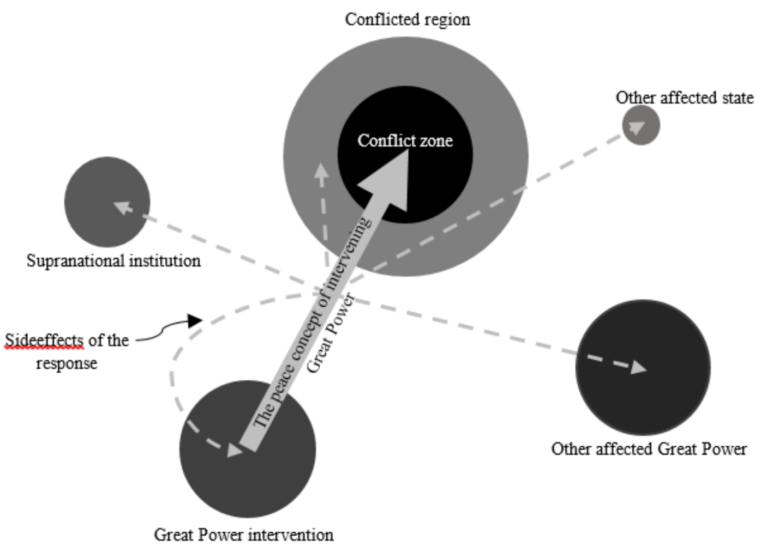
Why the definition of peace matters?
Because the peace concept(s) of involved parties define the response of international actors when a conflict erupts.
Because the peace concept(s) of involved and intervening actors define the conflicted country's and region's future for decades.
Because the form of intervention affects other international actors and the intervening actors as well. (E.g. Emergence of ISIS)
Source: Own editing

Slide 14
Bibliography
Kalevi J. Holsti: Peace and War. Armed Conflicts and the International order 1648-1989. Cambridge University Press, Cambridge, 1991.
Kenneth E. Boulding: Stable Peace. University of Texas Press, 1978.
Rummel, Rudolph J.: Death by Government. Transaction Publishers, New Brunswick, 2009
Internet sources are indicated in each case by a hyperlink.

Slide 15
Thank you for your
attention!

