Slide 1
SECURITY AND PEACE IN AN UNCERTAIN WORLD First module: Trends, theories and analytical frameworks
6. Legal Dimensions of Armed Conflicts Melinda Szappanyos, PhD Department of Political Science and International Studies University of Pécs

Slide 2
The following disclaimer shall be added to the inner pages of the publications and studies written by external independent bodies with support from the European Commission:
BG | Подкрепата на Европейската комисия за изготвянето на настоящата публикация не представлява одобрение на съдържанието, което отразява гледните точки само на авторите и не може да се търси отговорност от Комисията за всяка употреба, която може да бъде използвана за информацията, съдържаща се в нея.
CS | Podpora Evropské komise při tvorbě této publikace nepředstavuje souhlas s obsahem, který odráží pouze názory autorů, a Komise nemůže být zodpovědná za jakékoliv využití informací obsažených v této publikaci.
DA | Europa-Kommissionens støtte til produktionen af denne publikation udgør ikke en godkendelse af indholdet, som kun afspejler forfatternes egne synspunkter, og Kommissionen kan ikke holdes ansvarlig for den brug, der måtte blive gjort af de deri indeholdte oplysninger.
DE | Die Unterstützung der Europäischen Kommission für die Erstellung dieser Veröffentlichung stellt keine Billigung des Inhalts dar, welcher nur die Ansichten der Verfasser wiedergibt, und die Kommission kann nicht für eine etwaige Verwendung der darin enthaltenen Informationen haftbar gemacht werden.
EL | Η υποστήριξη της Ευρωπαϊκής Επιτροπής στην παραγωγή της παρούσας έκδοσης δεν συνιστά αποδοχή του περιεχομένου, το οποίο αντικατοπτρίζει αποκλειστικά τις απόψεις των συντακτών, και η Επιτροπή δεν μπορεί να αναλάβει την ευθύνη για οποιαδήποτε χρήση των πληροφοριών που περιέχονται σε αυτήν.
EN | The European Commission's support for the production of this publication does not constitute an endorsement of the contents, which reflect the views only of the authors, and the Commission cannot be held responsible for any use which may be made of the information contained therein.
ES | El apoyo de la Comisión Europea para la producción de esta publicación no constituye una aprobación del contenido, el cual refleja únicamente las opiniones de los autores, y la Comisión no se hace responsable del uso que pueda hacerse de la información contenida en la misma.
ET | Euroopa Komisjoni toetus käesoleva väljaande koostamisele ei tähenda väljaandes esitatud sisu kinnitamist. Väljaandes esitatud sisu peegeldab vaid autorite seisukohti. Euroopa Komisjon ei vastuta selles sisalduva teabe kasutamise eest.
FI | Euroopan komission tuki tämän julkaisun tuottamiseen ei tarkoita sitä, että sisältö, joka kuvastaa pelkästään tekijöiden näkemyksiä, saa kannatusta, eikä komissiota voida saattaa vastuuseen niiden sisältämien tietojen mahdollisesta käytöstä.
FR | Le soutien de la Commission européenne à la production de cette publication ne constitue pas une approbation du contenu, qui reflète uniquement le point de vue des auteurs, et la Commission ne peut pas être tenue responsable de toute utilisation qui pourrait être faite des informations qu’elle contient.
GA | Ní hionann tacaíocht an Choimisiúin Eorpaigh do tháirgeadh an fhoilseacháin seo agus formhuiniú ar ábhair an fhoilseacháin, lena léirítear tuairimí na n-údar amháin, agus ní féidir freagracht a chur ar an gCoimisiún as aon úsáid a d’fhéadfaí a bhaint as an bhfaisnéis atá ann.
HR | Potpora Europske komisije proizvodnji ove publikacije ne predstavlja potporu sadržaju koji odražava samo stavove autora i Komisija ne može biti odgovorna za uporabu sadržanih informacija.

Slide 3
HU | Az Európai Bizottság támogatása ezen kiadvány elkészítéséhez nem jelenti a tartalom jóváhagyását, amely kizárólag a szerzők álláspontját tükrözi, valamint a Bizottság nem tehető felelőssé ezen információk bárminemű felhasználásáért.
IT | Il sostegno della Commissione europea alla produzione di questa pubblicazione non costituisce un'approvazione del contenuto, che riflette esclusivamente il punto di vista degli autori, e la Commissione non può essere ritenuta responsabile per l'uso che può essere fatto delle informazioni ivi contenute.
LT | Europos Komisijos parama šio leidinio rengimui nereiškia pritarimo jo turiniui, kuriame pateikiama autorių nuomonė, todėl Europos Komisija negali būti laikoma atsakinga už informaciją panaudotą šiame leidinyje.
LV | Eiropas Komisijas atbalsts šīs publikācijas sagatavošanai nav uzskatāms par satura apstiprinājumu, kas atspoguļo tikai autoru viedokļus, un Komisija nevar būt atbildīga par tajā ietvertās informācijas jebkādu izmantošanu.
MT | L-appoġġ tal-Kummissjoni Ewropea għall-produzzjoni ta’ din il-pubblikazzjoni ma jikkostitwixxix approvazzjoni tal-kontenut, li jirrifletti biss il-fehmiet tal-awturi, u l-Kummissjoni ma tistax tinżamm responsabbli għal kwalunkwe użu li jista’ jsir mill-informazzjoni li tinsab fiha.
NL | De steun van de Europese Commissie voor de productie van deze publicatie houdt geen goedkeuring van de inhoud in. De inhoud geeft de standpunten van de auteurs weer en de Commissie kan niet aansprakelijk worden gesteld voor het gebruik dat eventueel wordt gemaakt van de daarin opgenomen informatie.
PL | Wsparcie Komisji Europejskiej dla produkcji tej publikacji nie stanowi poparcia dla treści, które odzwierciedlają jedynie poglądy autorów, a Komisja nie może zostać pociagnięta do odpowiedzialności za jakiekolwiek wykorzystanie informacji w niej zawartych.
PT | O apoio da Comissão Europeia à produção desta publicação não constitui um aval do seu conteúdo, que reflete unicamente o ponto de vista dos autores, e a Comissão não pode ser considerada responsável por eventuais utilizações que possam ser feitas com as informações nela contidas.
RO | Sprijinul acordat de Comisia Europeană pentru elaborarea acestei publicații nu constituie o aprobare a conținutului, care reflectă doar opiniile autorilor, iar Comisia nu poate fi trasă la răspundere pentru orice utilizare a informațiilor conținute în aceasta.
SK | Podpora Európskej komisie na výrobu tejto publikácie nepredstavuje súhlas s obsahom, ktorý odráža len názory autorov, a Komisia nemôže byť zodpovedná za prípadné použitie informácií, ktoré sú v nej obsiahnuté.
SL | Podpora Evropske komisije za pripravo te publikacije ne pomeni potrditve vsebine, ki izraža le mnenja avtorjev, in Komisija ne more biti odgovorna za kakršno koli uporabo informacij, ki jih vsebuje.
SV | Europeiska Kommissionens stöd åt framställningen av detta dokument utgör inte ett godkännande av dess innehåll, vilket endast återspeglar upphovsmännens åsikter, och Kommissionen kan inte hållas ansvarigt för någon användning av informationen i det.

Slide 4
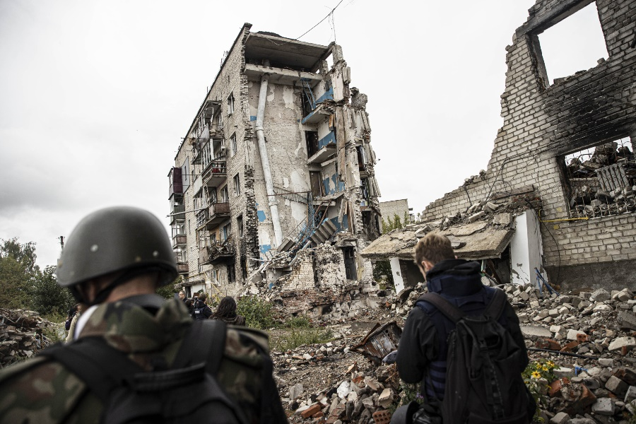
Introduction
Public International Law’s (PIL) stand on the prohibition of the use of force & peaceful settlement of disputes:
Both are found in international treaties (e.g. Charter of the UN)
Prohibition of the use of force: jus cogens (peremptory norm of PIL) → obligatory for the whole international community
Peaceful settlement of disputes: general principle → obligatory for the whole international community
Source: Amnesty International, https://www.amnesty.org/en/what-we-do/armed-conflict/

Slide 5
y
History
Prohibition of the use of force
Peacefull settlement of disputes
„Contracting Powers agree not to have recourse to armed force for the recovery of contract debts claimed from the Government of one country by the Government of another country as being due to its nationals” (Art 1)
„ […] not applicable when the debtor State refuses or neglects to reply to an offer of arbitration, or, after accepting the offer, prevents any compromis from being agreed on, or, after the arbitration, fails to submit to the award” (Art 1)
1907 Drago-Porter Convention
„Members of the League agree that they will not go to war with any party to the dispute which complies with the recommendations of the report” (Art 15)
„If there should arise between Members of the League any dispute likely to lead to a rupture, which is not submitted to arbitration or judicial settlement in accordance with Article 13, the Members of the League agree that they will submit the matter to the Council.” (Art 15)
1919 Covenant of the League of Nations

Slide 6
y
History
Prohibition of the use of force
Peacefull settlement of disputes
„The High Contracting Parties solemly declare in the names of their respective peoples that they condemn recourse to war for the solution of international controversies, and renounce it, as an instrument of national policy in their relations with one another.” (Art I)
The High Contracting Parties agree that the settlement or solution of all disputes or conflicts of whatever nature or of whatever origin they may be, which may arise among them, shall never be sought except by pacific means.” (Art II)
1928 Kellogg-Briand Pact
„All Members shall refrain in their international relations from the threat or use of force against the territorial integrity or political independence of any state, or in any other manner inconsistent with the Purposes of the United Nations.” (Art 2, para 4)
„All Members shall settle their international disputes by peaceful means in such a manner that international peace and security, and justice, are not endangered.” (Art 2, para 3)
1945 Charter of the United Nations

Slide 7
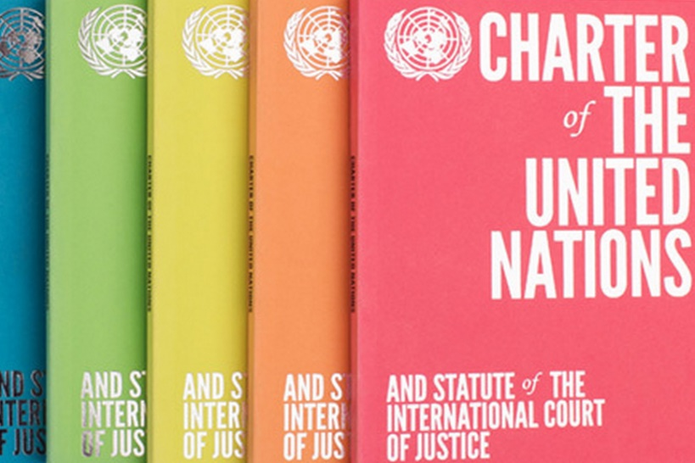
Prohibition of the use of force
GENERAL PROHIBITION
Article 2, para 4. + jus cogens
Confirmed by the case law of the International Court of Justice (e.g.):
Legality of the Threat or Use of Nuclear Weapons
Allegations of Genocide under the Convention on the Prevention and Punishment of the Crime of Genocide (Ukraine v. Russian Federation)
Exceptions built in the system:
UN Charter, Art 51: „Nothing in the present Charter shall impair the inherent right of individual or collective self-defence”
UN Charter, Art 42: „… Security Council […] may take such action by air, sea, or land forces as may be necessary to maintain or restore international peace and security”
Source: United Nations, https://www.un.org/en/about-us/un-charter

Slide 8
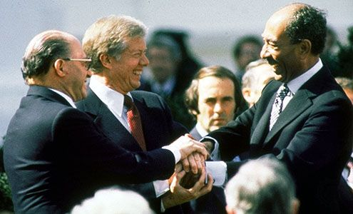
Peaceful settlement of disputes
GENERAL OBLIGATION
Article 2, para 3. + general principle
Confirmed by the case law of the International Court of Justice (e.g.):
Legality of the Threat or Use of Nuclear Weapons
Allegations of Genocide under the Convention on the Prevention and Punishment of the Crime of Genocide (Ukraine v. Russian Federation)
Exceptions built in the system:
UN Charter, Art 51: „Nothing in the present Charter shall impair the inherent right of individual or collective self-defence”
UN Charter, Art 42: „… Security Council […] may take such action by air, sea, or land forces as may be necessary to maintain or restore international peace and security”
Source: Encyclopedia Britannica https://www.britannica.com/event/Camp-David-Accords

Slide 9
Peaceful settlement of disputes - METHODS
By an international court
Arbitration (e.g. Permanent Court of Arbitration)
Permanent courts (e.g. International Court of Justice)
→ difference: freedom of the parties to chose the judges, the law to be applied and the procedure
By diplomatic means
Negotiation
Mediation
Good Offices
Conciliation
Via an international organization (e.g. UN Security Council under Chapter VI. of the UN Charter)
Source: Encyclopedia Britannica https://www.britannica.com/event/Camp-David-Accords

Slide 10
Legal assessment framework
 | State level | Regional int’l orgs (if any) | UN (and UN family) | Other stakeholders
Applicable legal sources
Legal assessment of the involved parties
Actions taken
YOUR legal assessment

Slide 11
Legal assessment framework
 | State level | Regional int’l orgs (if any) | UN (and UN family) | Other stakeholders
Applicable legal sources | For all participants: principle of non-intervention Charter of the UN: Art para 7 Responsibility of States for Internationally Wrongful Acts 2001 https://legal.un.org/ilc/texts/instruments/english/draft_articles/9_6_2001.pdf Arts. 40-41. | Founding treaties Responsibility of States for Internationally Wrongful Acts 2001 | Charter of the United Nations: Art 2 paras 3-4 Charter of the United Nations: Chapter VI. Responsibility of States for Internationally Wrongful Acts 2001 All SC resolutions: https://www.securitycouncilreport.org/un_documents_type/security-council-resolutions/?ctype=Syria&cbtype=syria | NGOs: their founding document and mission statement + international documents, depending on their mission: e.g. HR treaties for HR NGOs

Slide 12
Legal assessment framework
 | State level | Regional int’l orgs (if any) | UN (and UN family) | Other stakeholders
Legal assessment of the involved parties | US: Humanitarian situation makes intervention necessary RF: The intervention was requested by the government | Syrian Arab Republic violated the rights and obligations of their respective founding treaties | Civil war: not the concern of the internationa community, BUT Violation of jus cogens norms (HRs) In case of escalation: it may be either „dispute, the continuance of which is likely to endanger the maintenance of international peace and security” OR „threat to the peace, breach of the peace, or act of aggression” | Human rights violations (on both sides) → requires action Use of weapons of mass destruction → requires action Use of weapons

Slide 13
Legal assessment framework
 | State level | Regional int’l orgs (if any) | UN (and UN family) | Other stakeholders
Actions taken | Unilateral sanctions – e.g. US** | Organization of Islamic Cooperation:RESOLUTION 2/4-EX (IS) ON THE SITUATION IN SYRIA https://www.oic-oci.org/docdown/?docID=26&refID=8 League of Arab States: suspension of membership in 2011.* | UNSC: Called the parties to stop hostilities UN-OPCW Joint Investigative Mechanism (together with UN Secretary-General) UNGA: A/RES/72/191 "Situation of Human Rights in the Syrian Arab Republic„ UNICEF + HRC: https://news.un.org/en/focus/syria | EXAMPLES ONLY: Human Rights Watch: https://www.hrw.org/middle-east/n-africa/syria Syrian NGOSs: https://arab.org/countries/syria/
*Interesting actuality: the Arab League is considering negotiations https://www.reuters.com/world/middle-east/saudi-foreign-minister-syria-could-return-arab-league-not-yet-2023-03-07/
** See actuality: https://www.ohchr.org/en/press-releases/2020/12/us-must-remove-sanctions-and-allow-syria-rebuild-un-expert

Slide 14
Legal assessment framework
 | State level | Regional int’l orgs (if any) | UN (and UN family) | Other stakeholders
YOUR legal assessment | This assessment is NOT about who is wrong or right… But about who’s claim(s) complies with international law better. E.g.: Is humanitarian intervention/preventive intervention accepted by international law?

Slide 15
Bibliography – international documents
International treaties
Drago-Porter Convetion: https://avalon.law.yale.edu/20th_century/hague072.asp
Covenant of the League of Nations: https://www.ungeneva.org/en/library-archives/league-of-nations/covenant
Kellogg-Briand Pact: https://avalon.law.yale.edu/20th_century/kbpact.asp
UN Charter: https://www.un.org/en/about-us/un-charter
Jurisprudence of the ICJ
Allegations of Genocide under the Convention on the Prevention and Punishment of the Crime of Genocide (Ukraine v. Russian Federation): https://www.icj-cij.org/case/182
Legality of the Threat or Use of Nuclear Weapons: https://www.icj-cij.org/case/95
Book
Malcolm N. Shaw: International Law, 8th edition, Cambridge UP, 2017. Chapters 17 & 19.

Slide 16
Thank you for your
attention!

